Slide 1
ECEN 150 Circuit Analysis I
Frequency Response

Slide 2
Exponents and Logarithms
a = b^{x}, where a is the argument, b is the base and x is the exponent.
What b^{x} corresponds to a?
x = log_{b}a.
For example, 10^{x} = 10,000. What exponent x for the base 10 results in 10,000?
x = log₁₀(10,000) = 4, which means that 10⁴ = 10,000.
For example, 2^{x} = 4096. What exponent x for the base 2 results in 16?
x = log₂(4096) = 12, which means that 2¹² = 4096.

Slide 3
Exponents and Logarithms (Continued)
By definition, base b > 0. So, for any real exponent x, b^{x} ≥ 0.
Even 10⁻¹⁰⁰ > 0, although very close to zero.
So argument a = b^{x} ≥ 0. For -∞ ≤ x ≤ 0, 0 ≤ a = b^{x} ≤ 1.
Logarithms are only defined for positive arguments a.
log_{b}(0) corresponds to 0 = b^{x}, which is true for exponent x = -∞.
Logarithms useful for wide ranging quantities, such as the magnitude of seismic oscillations (Richter scale), dynamic range of human hearing, amplifier gain levels, and filter attenuation levels.
In science and engineering there is no escaping the need to become proficient with logarithms.
Some Important Logarithmic Properties:
log(P₁P₂) = log(P₁) + log(P₂). Similarly, log(P₁/P₂) = log(P₁) - log(P₂).
log(P)^{n} = nlog(P).
log(1) = 0.
Exponential form
Logarithmic form
exponent
a = b^{x} x = log_{b}a
base

Slide 4
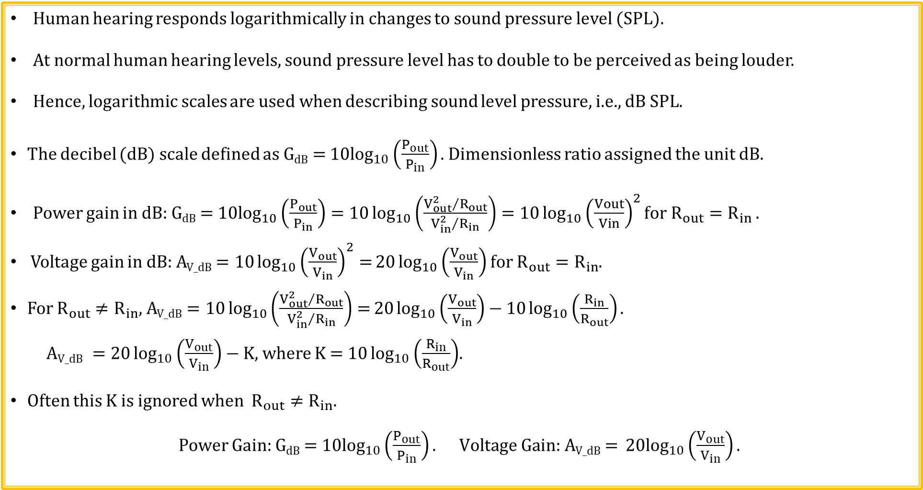
decibels (dB)
Human hearing responds logarithmically in changes to sound pressure level (SPL).
At normal human hearing levels, sound pressure level has to double to be perceived as being louder.
Hence, logarithmic scales are used when describing sound level pressure, i.e., dB SPL.
The decibel (dB) scale defined as G_{dB} = ${10log}_{10}\left(\frac{P_{out}}{P_{in}}\right)\text{. }$Dimensionless ratio assigned the unit dB.
Power gain in dB: G_{dB} = ${10log}_{10}\left(\frac{P_{out}}{P_{in}}\right)=10\log_{10}\left(\frac{{V_{out}^{2}}/{R_{out}}}{{V_{in}^{2}}/{R_{in}}}\right)=10\log_{10}{{\left(\frac{Vout}{Vin}\right)}^{2}for R_{out}=R_{in}}.$
Voltage gain in dB: A_{V_dB} $=10\log_{10}{{\left(\frac{V_{out}}{V_{in}}\right)}^{2}=}20\log_{10}\left(\frac{V_{out}}{V_{in}}\right)$ for $R_{out}=R_{in}$.
For $R_{out}≠R_{in}$, A_{V_dB} $=10\log_{10}\left(\frac{{V_{out}^{2}}/{R_{out}}}{{V_{in}^{2}}/{R_{in}}}\right)=20\log_{10}\left(\frac{V_{out}}{V_{in}}\right)−$ $10\log_{10}\left(\frac{R_{in}}{R_{out}}\right).$
$\text{A}\text{V}\text{_}\text{dB} =20\log_{10}\left(\frac{V_{out}}{V_{in}}\right)−$ K, where K = $10\log_{10}\left(\frac{R_{in}}{R_{out}}\right)$.
Often this K is ignored when $R_{out}≠R_{in}$.
Power Gain: G_{dB} = ${10log}_{10}\left(\frac{P_{out}}{P_{in}}\right). \text{Voltage} \text{Gain}\text{: }\text{A}\text{V}\text{_}\text{dB}\text{ = }{20log}_{10}\left(\frac{V_{out}}{V_{in}}\right).$

Slide 5
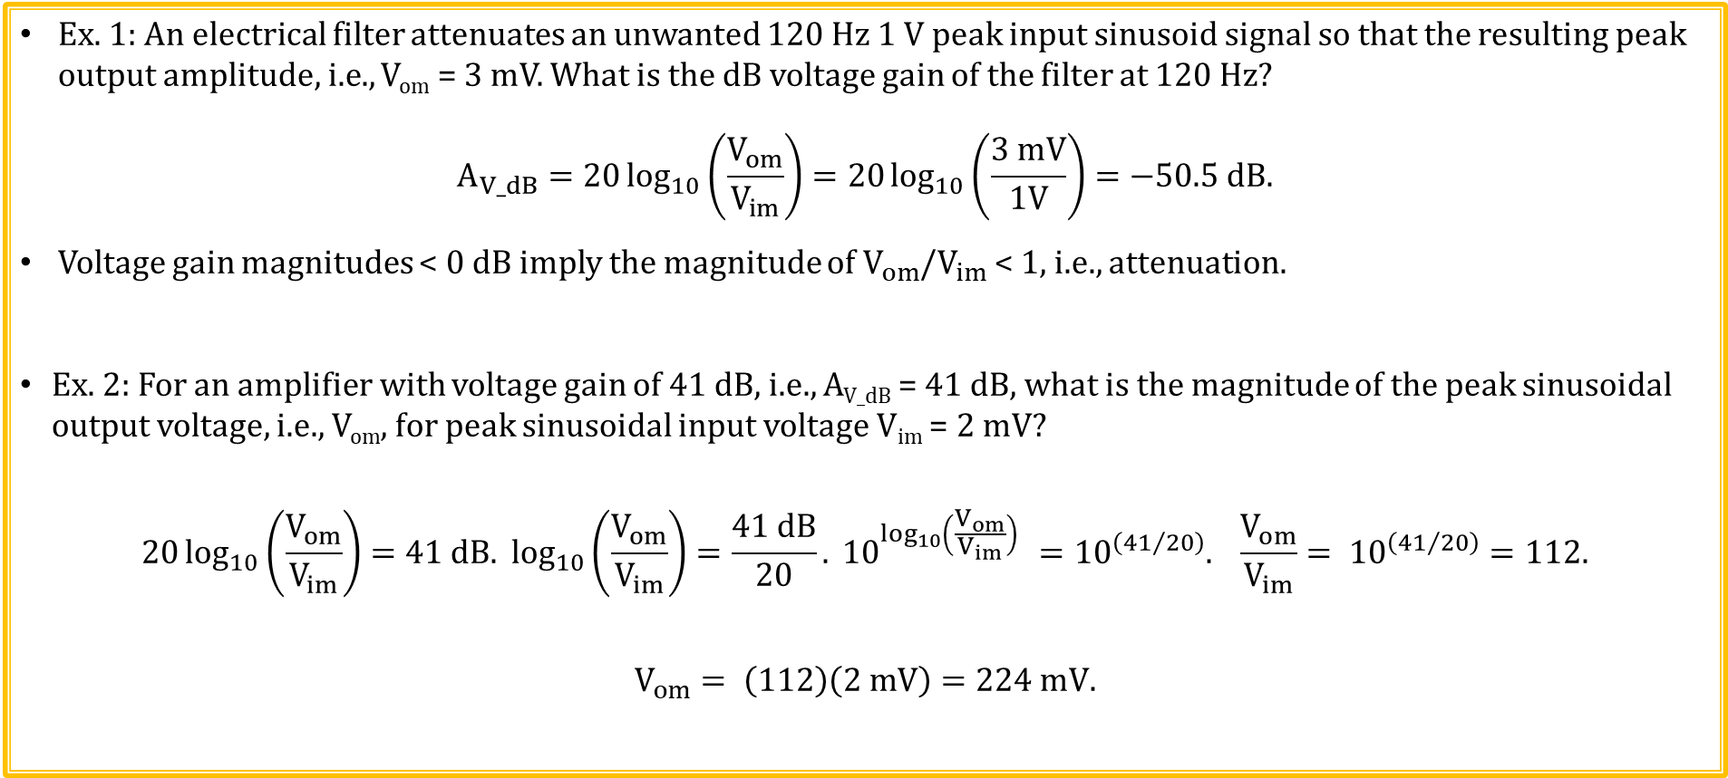
Voltage (dB) Examples
Ex. 1: An electrical filter attenuates an unwanted 120 Hz 1 V peak input sinusoid signal so that the resulting peak output amplitude, i.e., V_{om} = 3 mV. What is the dB voltage gain of the filter at 120 Hz?
$$A_{V_dB}=20\log_{10}\left(\frac{V_{om}}{V_{im}}\right)=20\log_{10}\left(\frac{3 mV}{1V}\right)=−50.5 dB.$$
Voltage gain magnitudes < 0 dB imply the magnitude of $V_{om}$/$V_{im}$ < 1, i.e., attenuation.
Ex. 2: For an amplifier with voltage gain of 41 dB, i.e., A_{V_dB} = 41 dB, what is the magnitude of the peak sinusoidal output voltage, i.e., V_{om}, for peak sinusoidal input voltage V_{im} = 2 mV?
$$20\log_{10}\left(\frac{V_{om}}{V_{im}}\right)=41 dB. \log_{10}\left(\frac{V_{om}}{V_{im}}\right)=\frac{41 dB}{20}. {10}^{\log_{10}\left(\frac{V_{om}}{V_{im}}\right) }={10}^{\left({41}/{20}\right)}. \frac{V_{om}}{V_{im}}= {10}^{\left({41}/{20}\right)}=112.$$
$$V_{om}= \left(112\right)\left(2 mV\right)=224 mV.$$

Slide 6
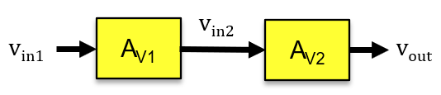
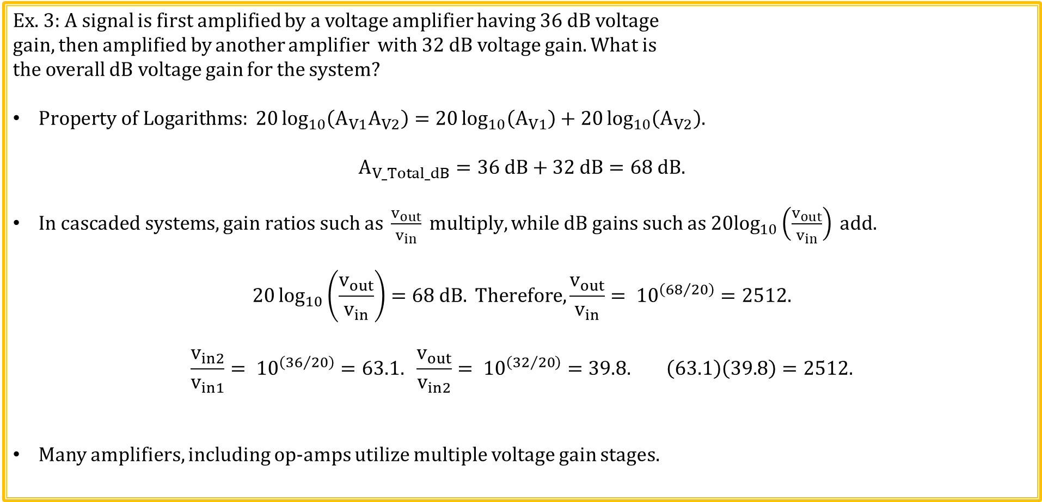
Voltage (dB) Examples (Continued)
Ex. 3: A signal is first amplified by a voltage amplifier having 36 dB voltage
gain, then amplified by another amplifier with 32 dB voltage gain. What is
the overall dB voltage gain for the system?
$Property of Logarithms: 20\log_{10}\left(A_{V1}A_{V2}\right)=20\log_{10}\left(A_{V1}\right)+20\log_{10}\left(A_{V2}\right).$
$$A_{V_Total_dB}=36 dB+32 dB=68 dB.$$
$In cascaded systems, gain ratios such as \frac{v_{out}}{v_{in}} multiply, while dB gains such as 20\log_{10}\left(\frac{v_{out}}{v_{in}}\right) add.$
$$20\log_{10}\left(\frac{v_{out}}{v_{in}}\right)=68 dB. Therefore,\frac{v_{out}}{v_{in}}= {10}^{\left({68}/{20}\right)}=2512.$$
$$\frac{v_{in2}}{v_{in1}}= {10}^{\left({36}/{20}\right)}=63.1. \frac{v_{out}}{v_{in2}}= {10}^{\left({32}/{20}\right)}=39.8. \left(63.1\right)\left(39.8\right)=2512.$$
Many amplifiers, including op-amps utilize multiple voltage gain stages.

Slide 7
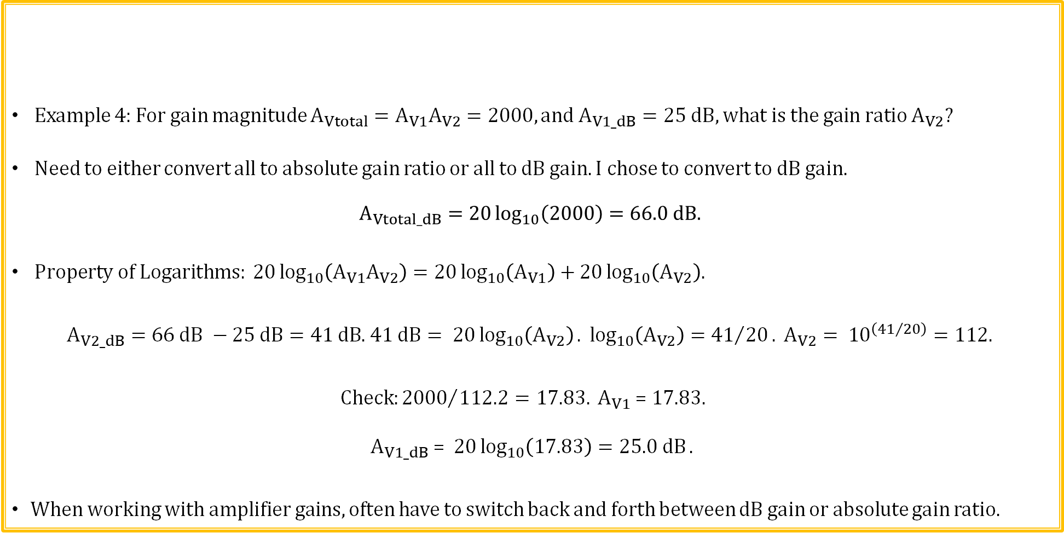
Voltage (dB) Examples (Continued)
Example 4: For gain magnitude $A_{Vtotal}=A_{V1}A_{V2}=2000, and A_{V1_dB}=25 dB, what is the gain ratio A_{V2}?$
Need to either convert all to absolute gain ratio or all to dB gain. I chose to convert to dB gain.
$$A_{Vtotal_dB}=20\log_{10}\left(2000\right)=66.0 dB.$$
$Property of Logarithms: 20\log_{10}\left(A_{V1}A_{V2}\right)=20\log_{10}\left(A_{V1}\right)+20\log_{10}\left(A_{V2}\right).$
$A_{V2_dB}=66 dB −25 dB=41 dB$. $41 dB= 20\log_{10}\left(A_{V2}\right). \log_{10}\left(A_{V2}\right)={41}/{20}. A_{V2}= {10}^{\left({41}/{20}\right)}=112.$
$$Check:{2000}/{112.2=17.83.} A_{V1}\text{ =}\text{ 17.83. }$$
$$A_{V1_dB}\text{ = }20\log_{10}\left(17.83\right)=25.0 dB.$$
When working with amplifier gains, often have to switch back and forth between dB gain or absolute gain ratio.
Poll Questions

Slide 8
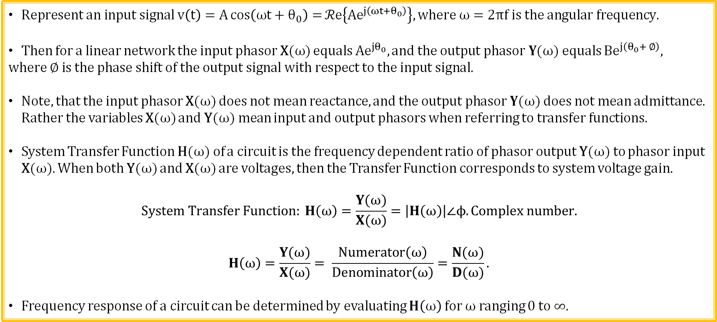
Transfer Function in Terms of Phasors: H(ω)
Input Phasor X(ω)
Linear Network
H(ω)
Output Phasor Y(ω)
$Represent an input signal v\left(t\right)=A\cos\left(ωt+θ_{0}\right)=ℛe\left\{{Ae}^{j\left(ωt+θ_{0}\right)}\right\}, where ω=2πf is the angular frequency.$
Then for a linear network the input phasor X(ω) equals ${Ae}^{jθ_{0}}, and the output phasor Y$(ω) equals B$e^{j\left(θ_{0}+ ∅\right)},$
$where ∅ is the phase shift of the output signal with respect to the input signal.$
Note, that the input phasor X(ω) does not mean reactance, and$the output phasor Y$(ω) does not mean admittance. Rather the variables X(ω) and Y(ω) mean input and output phasors when referring to transfer functions.
System Transfer Function H(ω) of a circuit is the frequency dependent ratio of phasor output Y(ω) to phasor input X(ω). When both Y(ω) and X(ω) are voltages, then the Transfer Function corresponds to system voltage gain.
$$System Transfer Function: H\left(ω\right)=\frac{Y(ω)}{X(ω)}=\left|H\left(ω\right)\right|∠ϕ. Complex number.$$
$$H\left(ω\right)=\frac{Y(ω)}{X(ω)}= \frac{Numerator\left(ω\right)}{Denominator\left(ω\right)}=\frac{N(ω)}{D(ω)}.$$
Frequency response of a circuit can be determined by evaluating $H\left(ω\right)$ for ω ranging 0 to ∞.

Slide 9
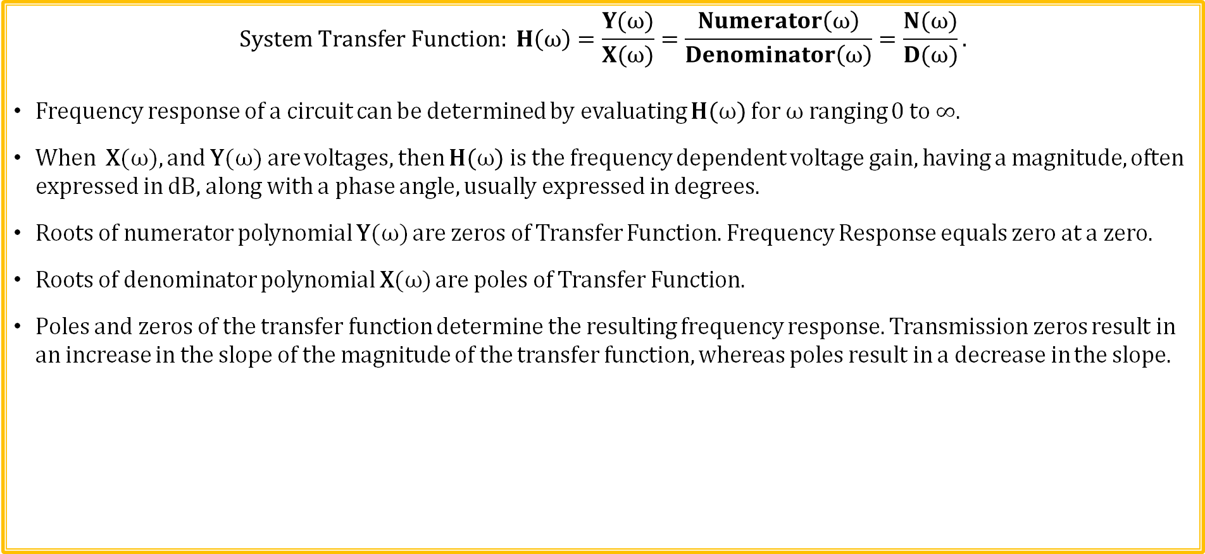
Transfer Function and Frequency Response
Phasor X(ω)
Linear Network
H(ω)
Phasor Y(ω)
$$System Transfer Function: H\left(ω\right)=\frac{Y(ω)}{X(ω)}=\frac{Numerator\left(ω\right)}{Denominator\left(ω\right)}=\frac{N(ω)}{D(ω)}.$$
Frequency response of a circuit can be determined by evaluating $H\left(ω\right)$ for ω ranging 0 to ∞.
When X(ω), and Y(ω) are voltages, then $H\left(ω\right)$ is the frequency dependent voltage gain, having a magnitude, often expressed in dB, along with a phase angle, usually expressed in degrees.
Roots of numerator polynomial Y(ω) are zeros of Transfer Function. Frequency Response equals zero at a zero.
Roots of denominator polynomial X(ω) are poles of Transfer Function.
Poles and zeros of the transfer function determine the resulting frequency response. Transmission zeros result in an increase in the slope of the magnitude of the transfer function, whereas poles result in a decrease in the slope.
|H(ω)| dB
|H(ω)| dB
Result of a Pole at 10² rad/s.
Result of a Zero at 10² rad/s.
10⁰
10⁴
Log Frequency (ω)
Log Frequency (ω)
10¹
10²
10³
10⁰
10¹
10²
10³
10⁴

Slide 10
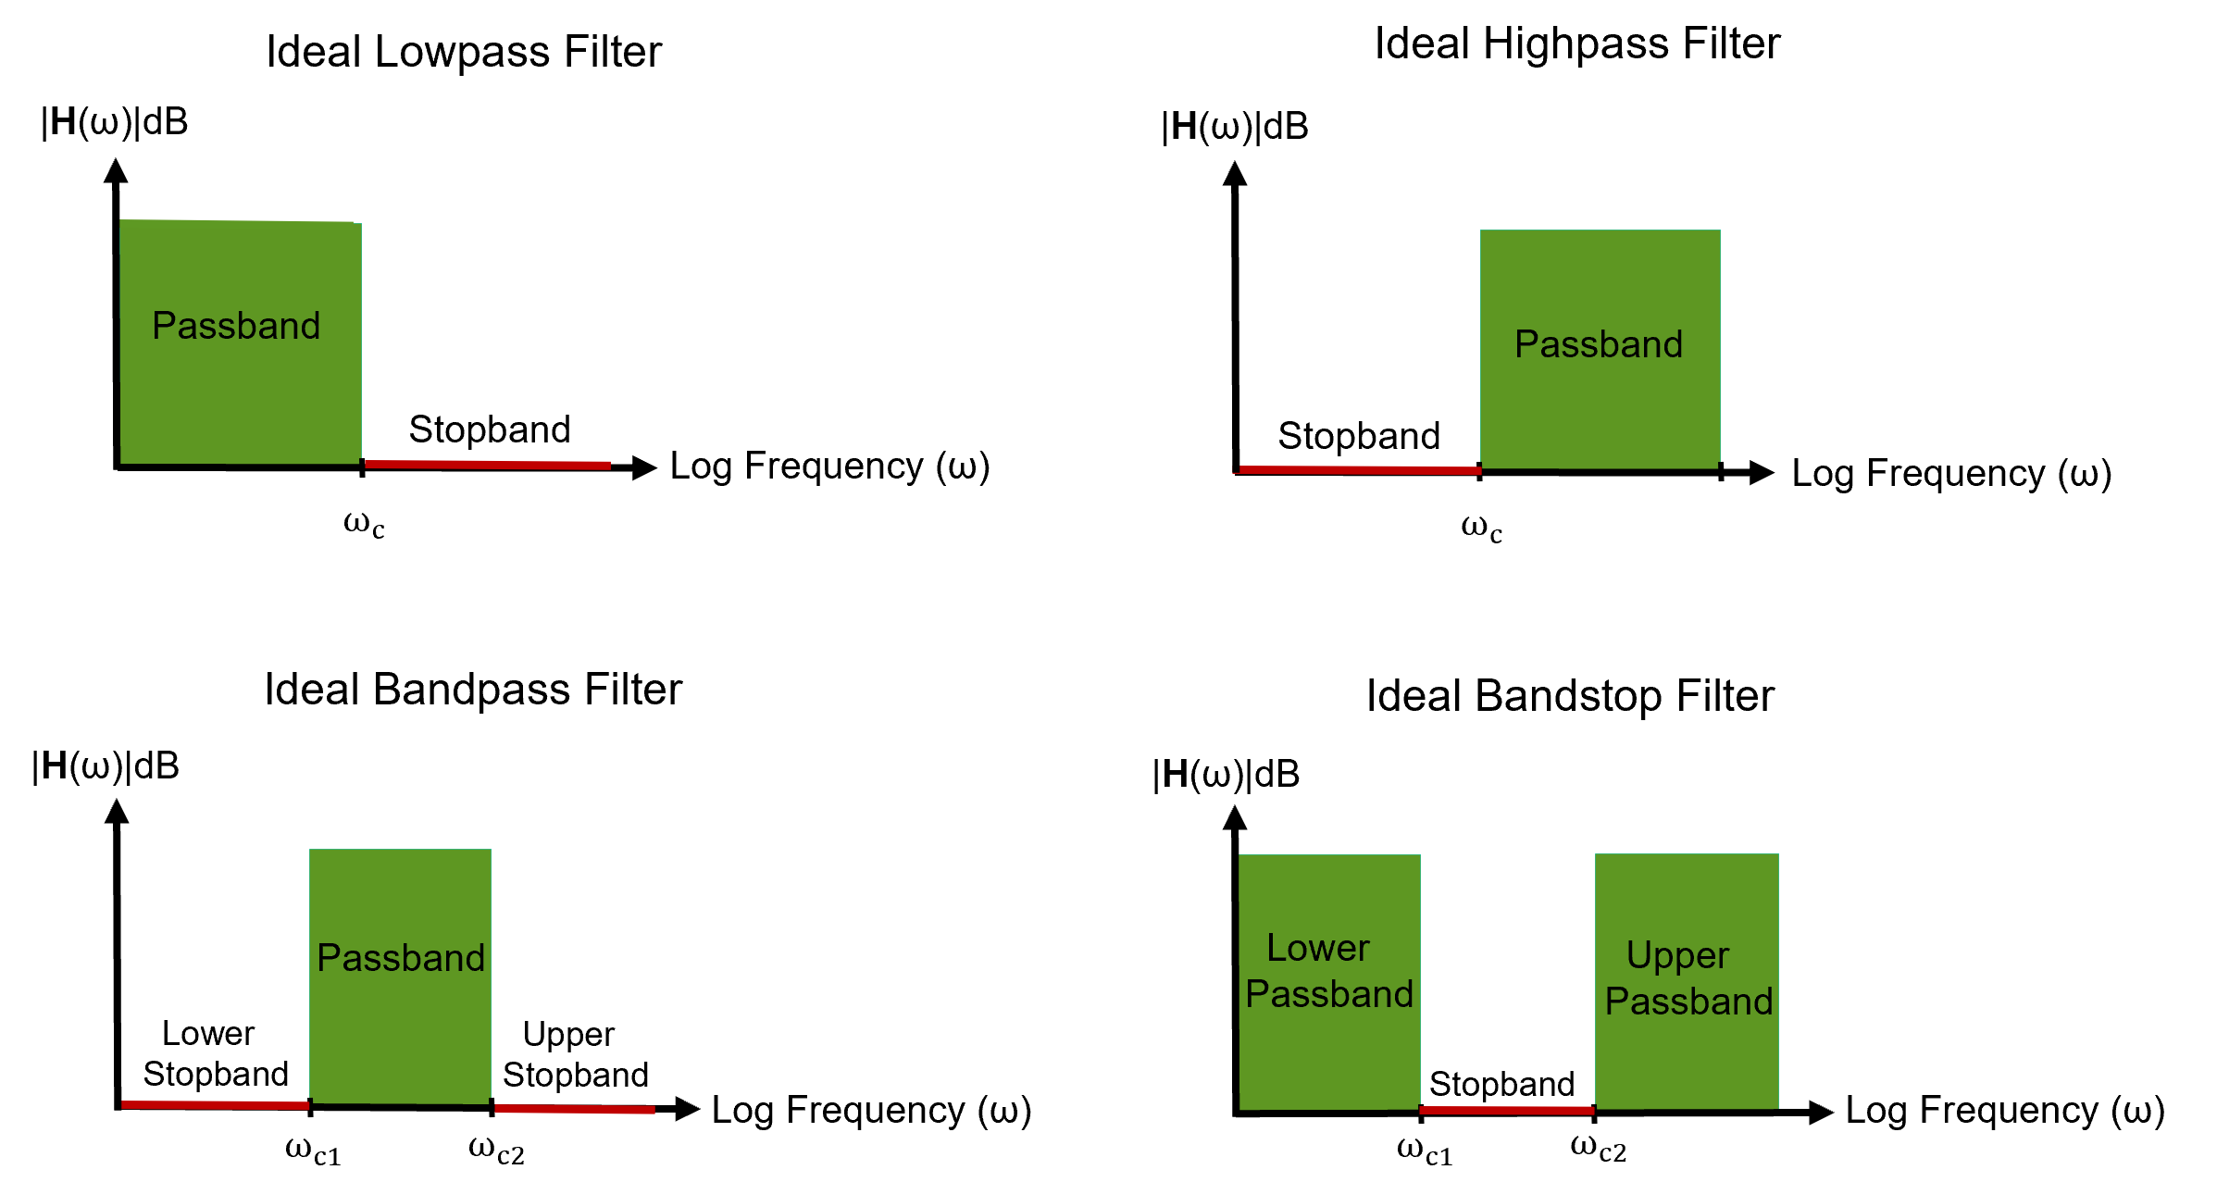
Basic Filter Types
Electrical filters are designed to allow some frequencies through, while blocking (attenuating) others, i.e., frequency discrimination.
A low-pass filter can be used to block (attenuate) unwanted high-frequency noise.

Slide 11
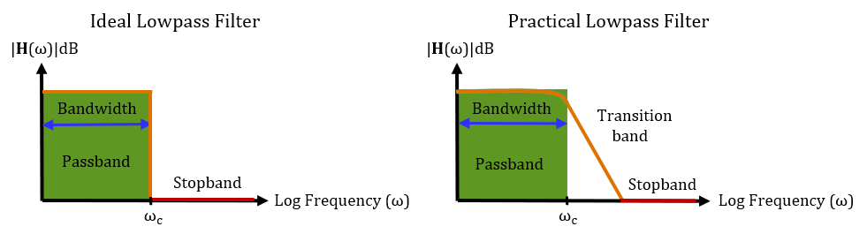
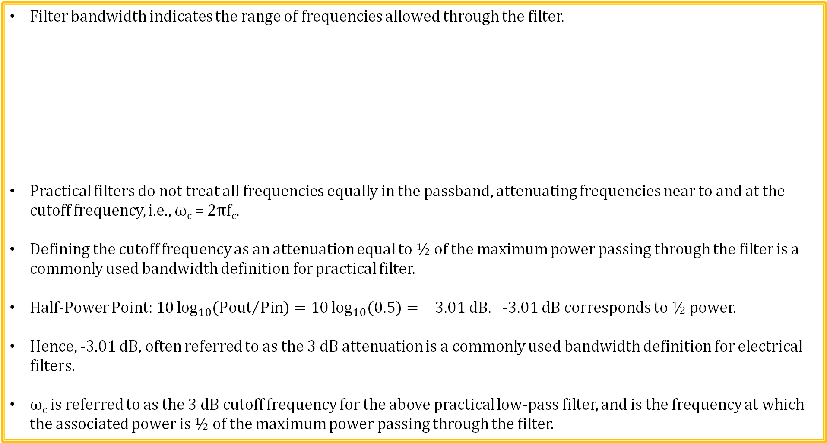
Filter Bandwidth
Filter bandwidth indicates the range of frequencies allowed through the filter.
Practical filters do not treat all frequencies equally in the passband, attenuating frequencies near to and at the cutoff frequency, i.e., ω_{c} = 2πf_{c}.
Defining the cutoff frequency as an attenuation equal to ½ of the maximum power passing through the filter is a commonly used bandwidth definition for practical filter.
Half-Power Point: $10\log_{10}\left({Pout}/{Pin}\right)=10\log_{10}\left(0.5\right)=−3.01 dB.$ -3.01 dB corresponds to ½ power.
Hence, -3.01 dB, often referred to as the 3 dB attenuation is a commonly used bandwidth definition for electrical filters.
ω_{c} is referred to as the 3 dB cutoff frequency for the above practical low-pass filter, and is the frequency at which the associated power is ½ of the maximum power passing through the filter.

Slide 12
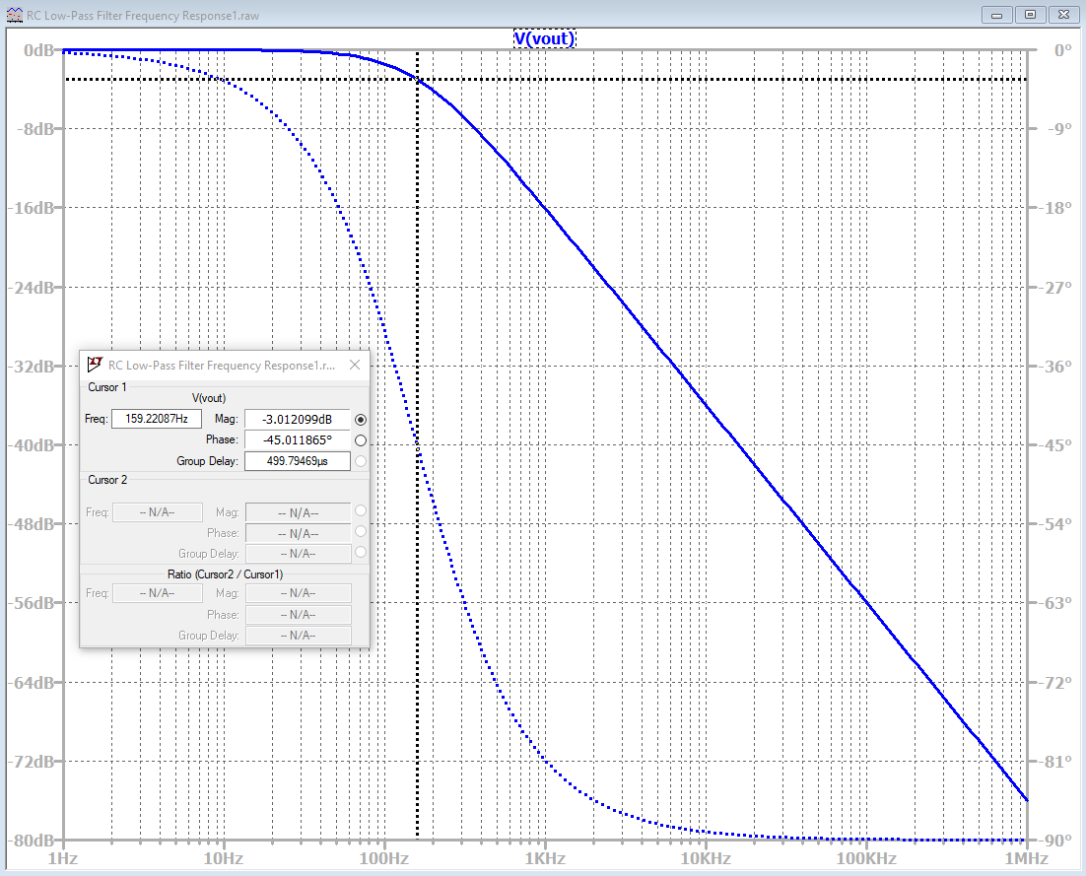
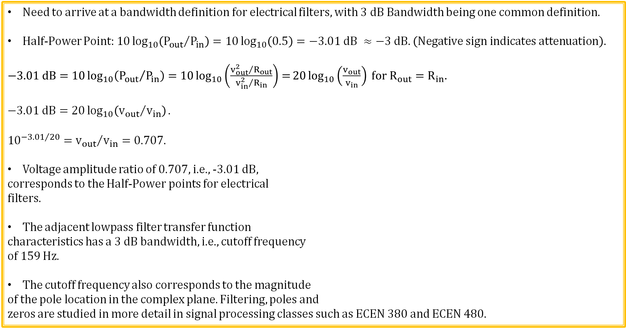
3 dB Bandwidth
Need to arrive at a bandwidth definition for electrical filters, with 3 dB Bandwidth being one common definition.
Half-Power Point: $10\log_{10}\left({P_{out}}/{P_{in}}\right)=10\log_{10}\left(0.5\right)=−3.01 dB ≈−3 dB. \left(Negative sign indicates attenuation\right).$
$−3.01 dB=10\log_{10}\left({P_{out}}/{P_{in}}\right)=10\log_{10}\left(\frac{{v_{out}^{2}}/{R_{out}}}{{v_{in}^{2}}/{R_{in}}}\right)=20\log_{10}\left(\frac{v_{out}}{v_{in}}\right) for R_{out}=R_{in}.$
$$−3.01 dB=20\log_{10}\left({v_{out}}/{v_{in}}\right).$$
${10}^{{−3.01}/{20}}={v_{out}}/{v_{in}}=0.707.$
Voltage amplitude ratio of 0.707, i.e., -3.01 dB,
corresponds to the Half-Power points for electrical
filters.
The adjacent lowpass filter transfer function
characteristics has a 3 dB bandwidth, i.e., cutoff frequency
of 159 Hz.
The cutoff frequency also corresponds to the magnitude
of the pole location in the complex plane. Filtering, poles and
zeros are studied in more detail in signal processing classes such as ECEN 380 and ECEN 480.

Slide 13
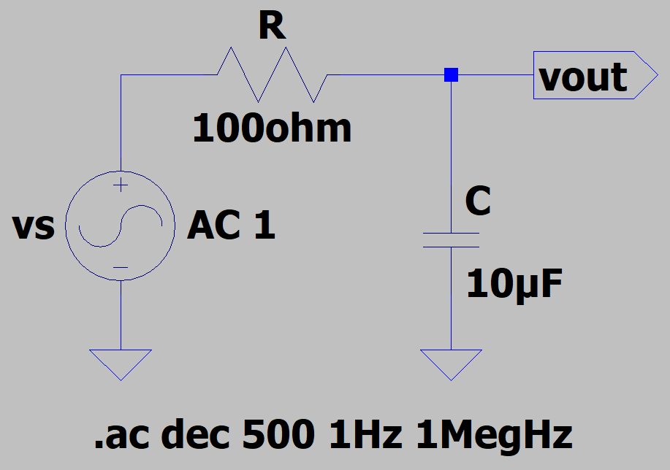
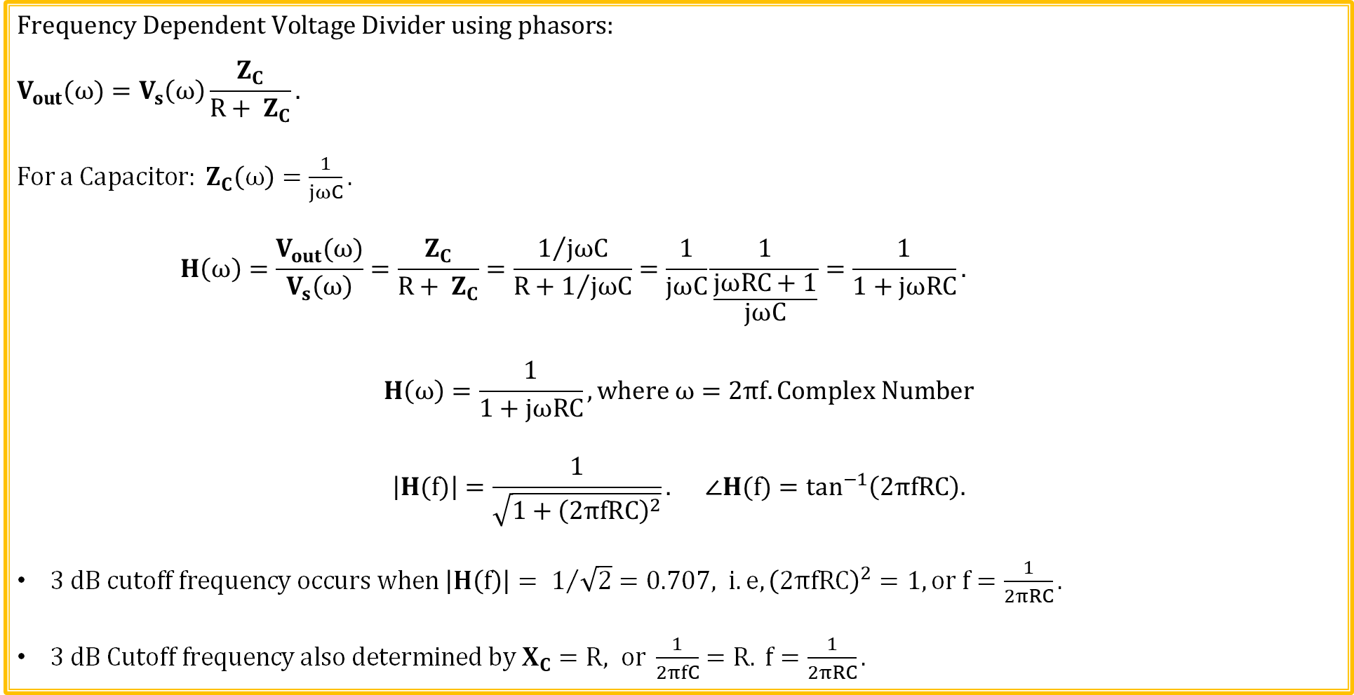
Transfer Function Example 1
$$Frequency Dependent Voltage Divider using phasors:$$
$$V_{out}(ω)=V_{s}\left(ω\right)\frac{Z_{C}}{R+ Z_{C}}.$$
For a Capacitor: $Z_{C}\left(ω\right)=\frac{1}{jωC}.$
$$H\left(ω\right)=\frac{V_{out}(ω)}{V_{s}\left(ω\right)}=\frac{Z_{C}}{R+ Z_{C}}=\frac{1/{jωC}}{R+1/{jωC}}=\frac{1}{jωC}\frac{1}{\frac{jωRC+1}{jωC}}=\frac{1}{1+jωRC}.$$
$$H\left(ω\right)=\frac{1}{1+jωRC}, where ω=2πf. Complex Number$$
$$\left|H(f)\right|=\frac{1}{\sqrt{1+{\left(2πfRC\right)}^{2}}}. ∠H(f)=\tan^{−1}\left(2πfRC\right).$$
$3 dB cutoff frequency occurs when \left|H\left(f\right)\right|= 1/{\sqrt{2}}=0.707, i.e, {\left(2πfRC\right)}^{2}=1, or f=\frac{1}{2πRC}.$
$3 dB Cutoff frequency also determined by X_{C}=R, or \frac{1}{2πfC}=R. f=\frac{1}{2πRC}.$

Slide 14
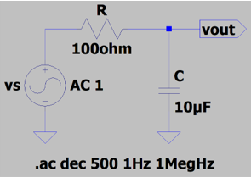
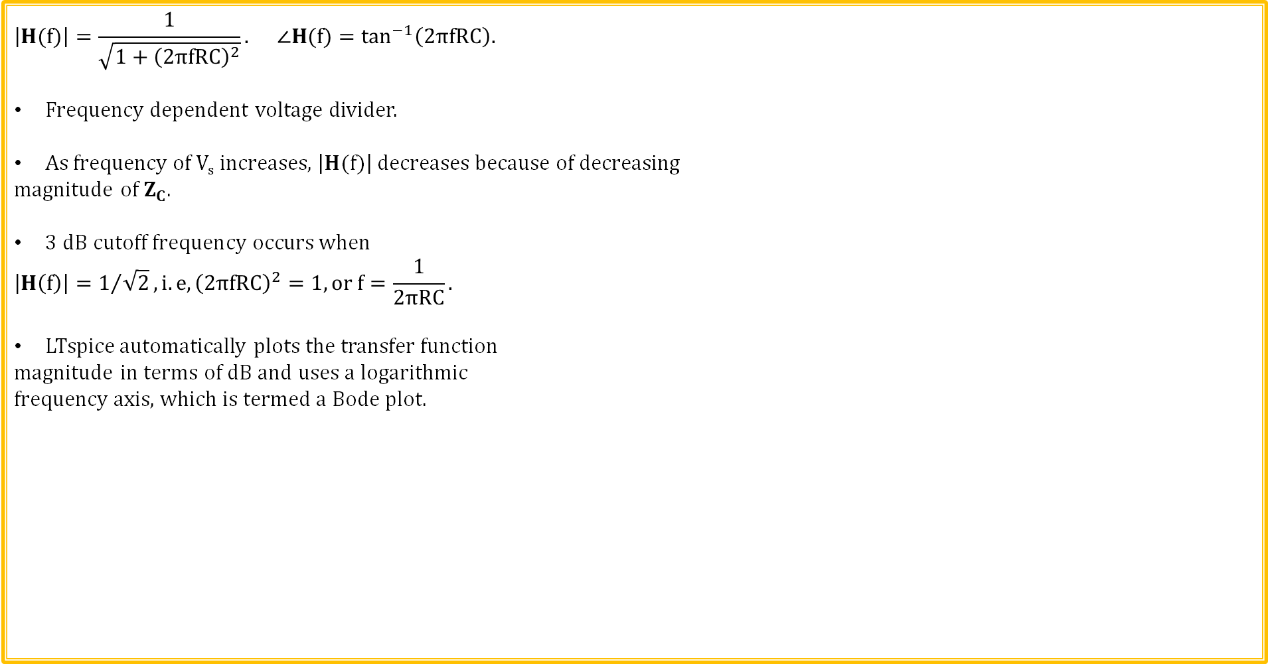
Transfer Function Example 1 (Continued)
$$\left|H(f)\right|=\frac{1}{\sqrt{1+{\left(2πfRC\right)}^{2}}}. ∠H(f)=\tan^{−1}\left(2πfRC\right).$$
Frequency dependent voltage divider.
As frequency of V_{s} increases, $\left|H(f)\right|$ decreases because of decreasing
magnitude of $Z_{C}$.
$3 dB cutoff frequency occurs when$
$$\left|H\left(f\right)\right|=1/{\sqrt{2}},i.e, {\left(2πfRC\right)}^{2}=1, or f=\frac{1}{2πRC}.$$
LTspice automatically plots the transfer function
magnitude in terms of dB and uses a logarithmic
frequency axis, which is termed a Bode plot.
LTspice

Slide 15
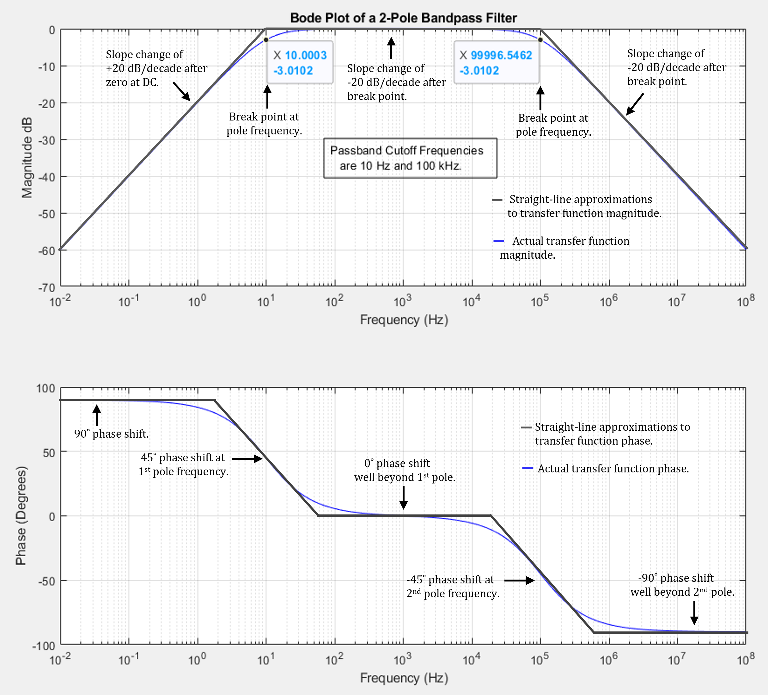
Bode Plots
Bode magnitude plot utilize dB magnitude and linear phase versus logarithmic frequency axis.
The logarithmic magnitude and frequency axes are beneficial when there are large differences between the minimum and maximum amplitudes and frequencies of interest.
Originally referred to a straight-line
approximation to the actual filter response,
but now also refers to exact calculated and/or
measured values.
Regarding the straight-line approximation to
the magnitude of the transfer function, the slope
increases by 20 dB/decade well beyond a pole
frequency. (The slope of the magnitude increases
by 20 dB/decade well beyond a zero frequency).
Regarding the straight-line approximation to
the phase shift of the transfer function, there is a
-45˚ phase shift at the pole frequency and a -90˚
phase shift well beyond the pole frequency.
(The phase shifts by +45˚ at a zero frequency
and +90˚ well beyond a zero frequency).

Slide 16
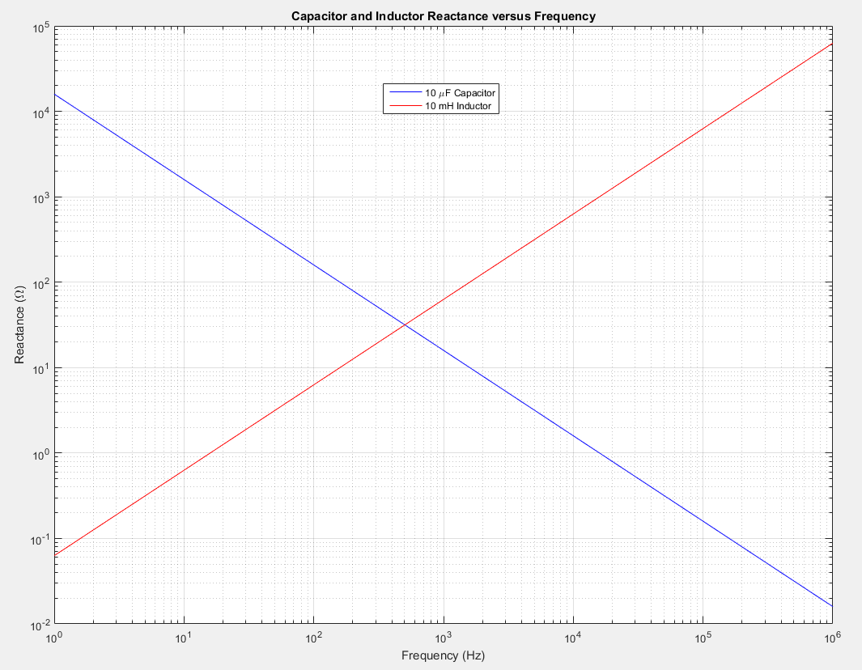
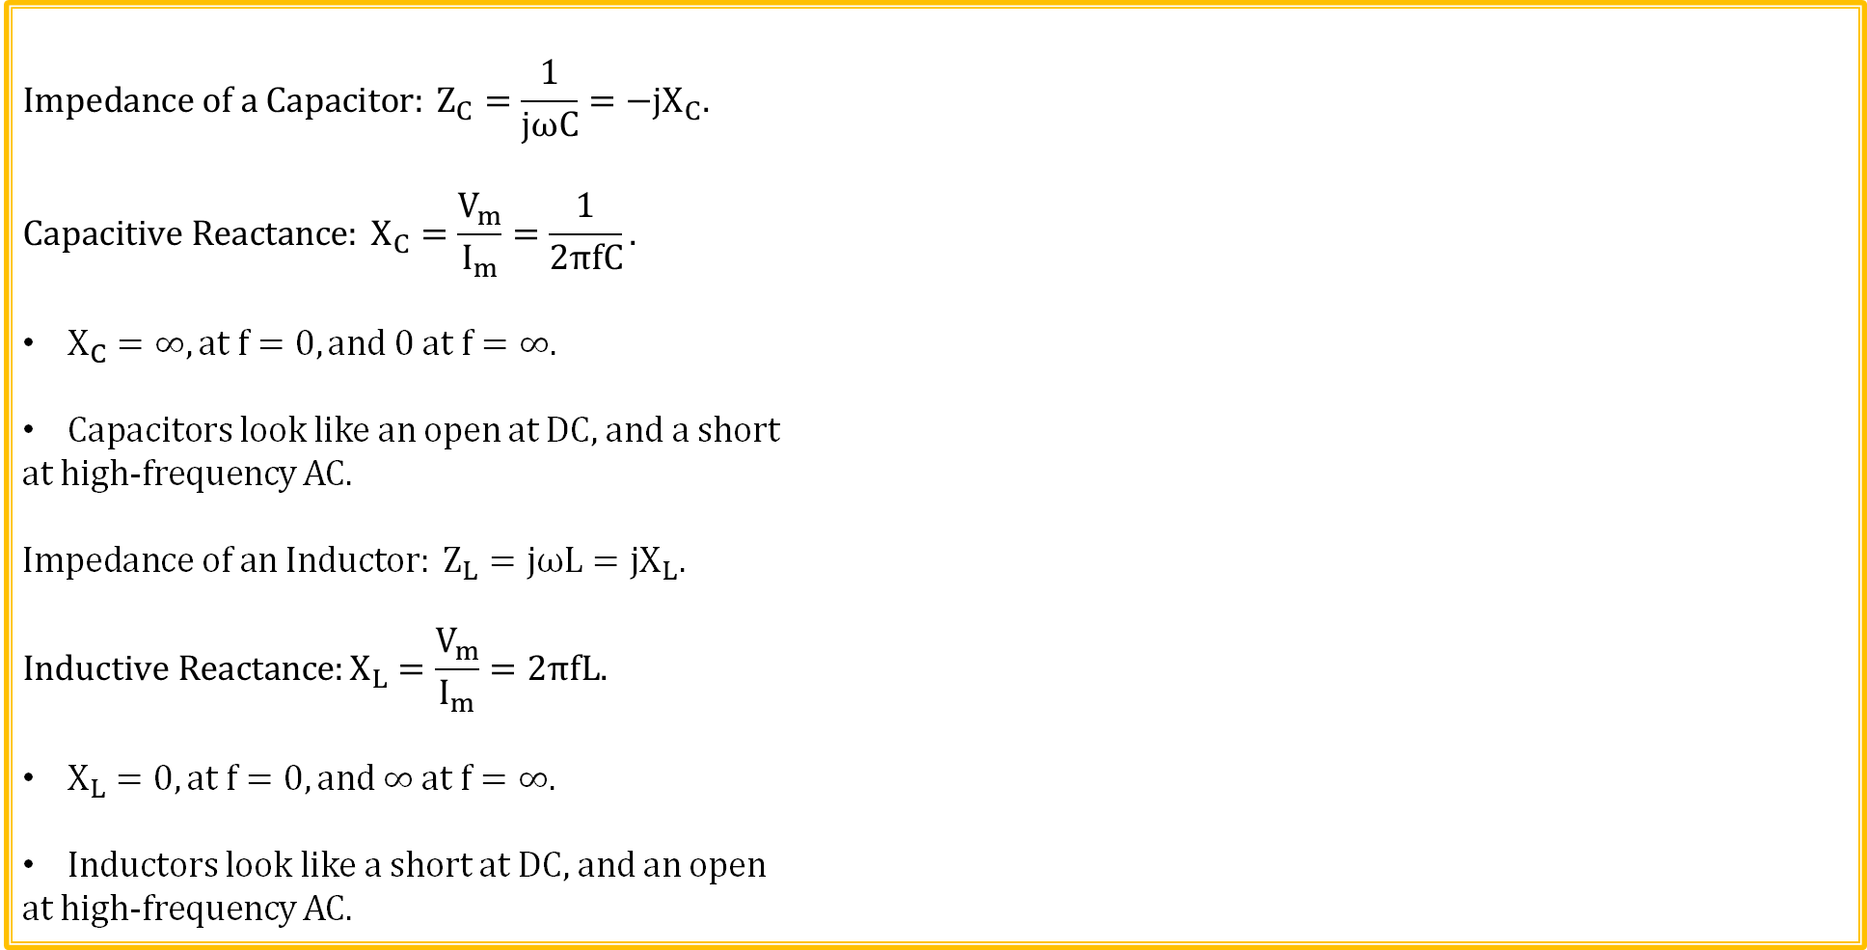
Reactance – Magnitude of Impedance
$$Impedance of a Capacitor: Z_{C}=\frac{1}{jωC}=−jX_{C}.$$
$$Capacitive Reactance: X_{C}=\frac{V_{m}}{I_{m}}=\frac{1}{2πfC}.$$
$X_{C}=∞, at f=0, and 0 at f=∞.$
Capacitors look like an open at DC, and a short
at high-frequency AC.
$$Impedance of an Inductor: Z_{L}=jωL=jX_{L}.$$
$$Inductive Reactance:X_{L}=\frac{V_{m}}{I_{m}}=2πfL.$$
$X_{L}=0, at f=0, and ∞ at f=∞.$
Inductors look like a short at DC, and an open
at high-frequency AC.

Slide 17
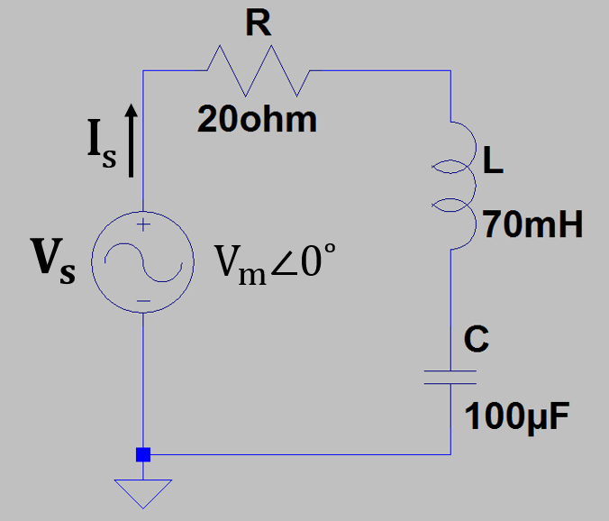
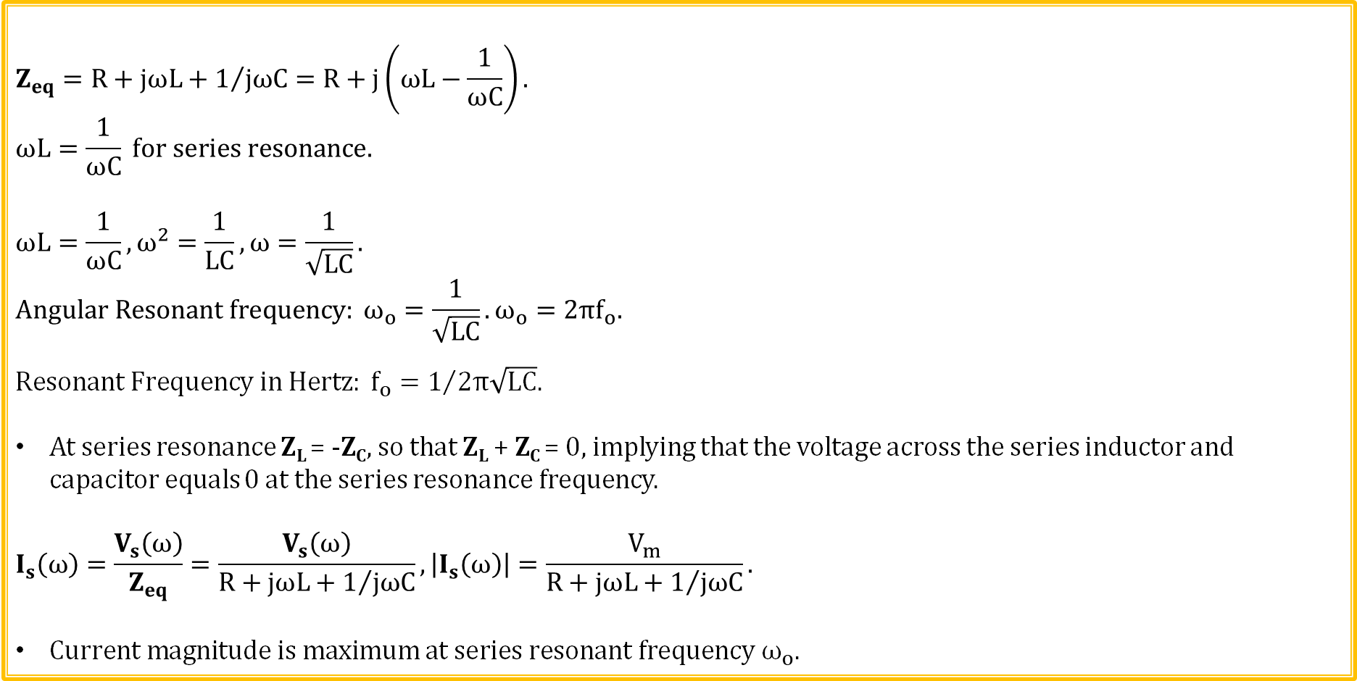
Series Resonance
$$Z_{eq}=R+jωL+1/{jωC}=R+j\left(ωL−\frac{1}{ωC}\right).$$
$$ωL=\frac{1}{ωC} for series resonance.$$
$$ωL=\frac{1}{ωC}, ω^{2}=\frac{1}{LC}, ω=\frac{1}{\sqrt{LC}}.$$
$$Angular Resonant frequency: ω_{o}=\frac{1}{\sqrt{LC}}.ω_{o}=2πf_{o}.$$
$${Resonant Frequency in Hertz: f_{o}=1}/{2π\sqrt{LC}.}$$
At series resonance Z_{L} = -Z_{C}, so that Z_{L} + Z_{C} = 0, implying that the voltage across the series inductor and capacitor equals 0 at the series resonance frequency.
$$I_{s}\left(ω\right)=\frac{V_{s}\left(ω\right)}{Z_{eq}}=\frac{V_{s}\left(ω\right)}{R+jωL+1/{jωC}}, \left|I_{s}\left(ω\right)\right|=\frac{V_{m}}{R+jωL+1/{jωC}}.$$
$Current magnitude is maximum at series resonant frequency ω_{o}.$

Slide 18
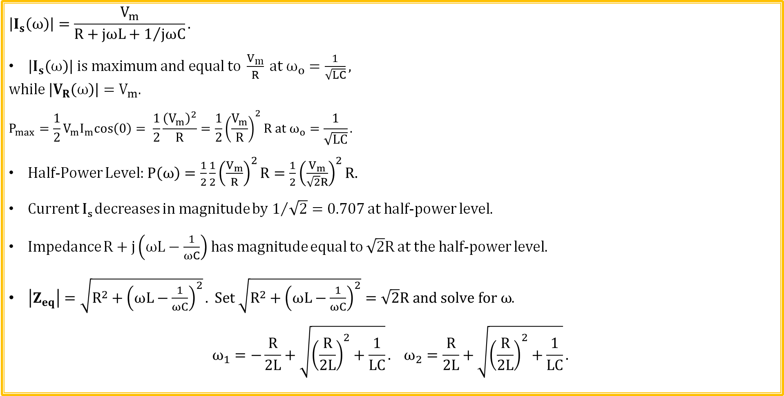
Series Resonance (Continued)
$$\left|I_{s}\left(ω\right)\right|=\frac{V_{m}}{R+jωL+1/{jωC}}.$$
$\left|I_{s}\left(ω\right)\right| is maximum and equal to \frac{V_{m}}{R} at ω_{o}=\frac{1}{\sqrt{LC}},$
$while$ $\left|V_{R}\left(ω\right)\right|=V_{m}.$
$$P_{max}=\frac{1}{2}V_{m}I_{m}cos\left(0\right)= \frac{1}{2}\frac{{\left(V_{m}\right)}^{2}}{R}=\frac{1}{2}{\left(\frac{V_{m}}{R}\right)}^{2}R at ω_{o}=\frac{1}{\sqrt{LC}}.$$
Half-Power Level: $P\left(ω\right)=\frac{1}{2}\frac{1}{2}{\left(\frac{V_{m}}{R}\right)}^{2}R=\frac{1}{2}{\left(\frac{V_{m}}{\sqrt{2}R}\right)}^{2}R.$
Current I_{s} decreases in magnitude by $1/{\sqrt{2}=0.707}$ at half-power level.
Impedance $R+j\left(ωL−\frac{1}{ωC}\right)$ has magnitude equal to $\sqrt{2}R$ at the half-power level.
$\left|Z_{eq}\right|=\sqrt{R^{2}+{\left(ωL−\frac{1}{ωC}\right)}^{2}}. Set \sqrt{R^{2}+{\left(ωL−\frac{1}{ωC}\right)}^{2}}=\sqrt{2}R and solve for ω$.
$$ω_{1}=−\frac{R}{2L}+\sqrt{{\left(\frac{R}{2L}\right)}^{2}+\frac{1}{LC}}. ω_{2}=\frac{R}{2L}+\sqrt{{\left(\frac{R}{2L}\right)}^{2}+\frac{1}{LC}}.$$

Slide 19
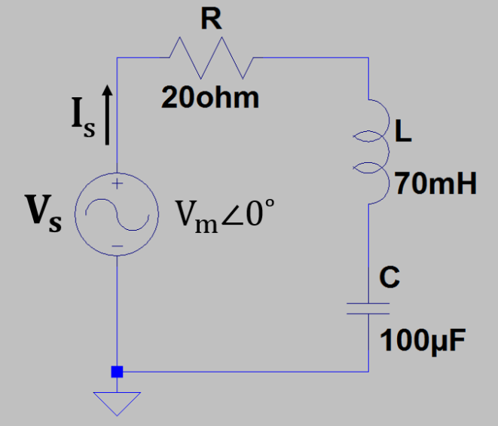
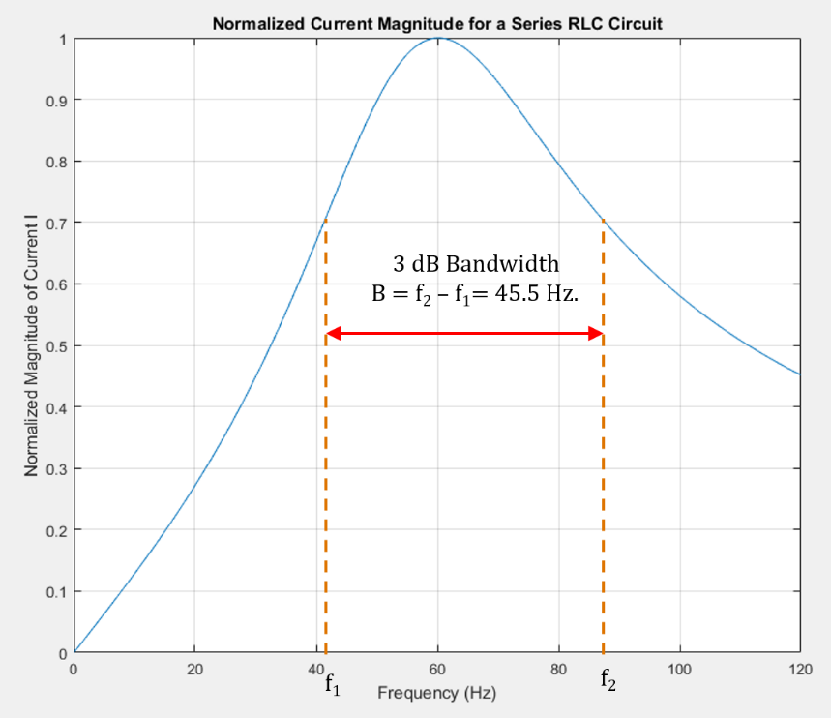
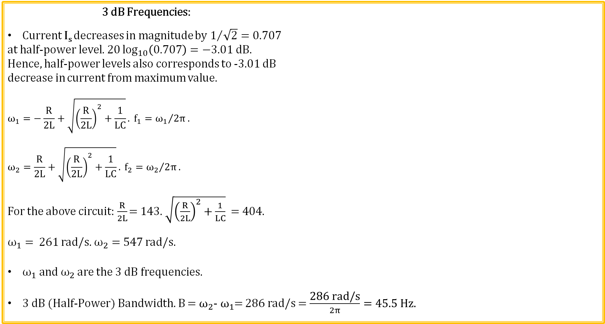
Series Resonance (Continued)
3 dB Frequencies:
Current I_{s} decreases in magnitude by $1/{\sqrt{2}=0.707}$
at half-power level.$20\log_{10}\left(0.707\right)=−3.01 dB.$
Hence, half-power levels also corresponds to -3.01 dB
decrease in current from maximum value.
$$ω_{1}=−\frac{R}{2L}+\sqrt{{\left(\frac{R}{2L}\right)}^{2}+\frac{1}{LC}}. f_{1}={ω_{1}}/{2π}.$$
$$ω_{2}=\frac{R}{2L}+\sqrt{{\left(\frac{R}{2L}\right)}^{2}+\frac{1}{LC}}. f_{2}={ω_{2}}/{2π}.$$
For the above circuit:$\frac{R}{2L}$ = 143. $\sqrt{{\left(\frac{R}{2L}\right)}^{2}+\frac{1}{LC}}$ = 404.
$ω_{1}=$ 261 rad/s. $ω_{2}=$ 547 rad/s.
$ω_{1} and ω_{2}$ are the 3 dB frequencies.
3 dB (Half-Power) Bandwidth. B = $ω_{2}$-${ ω}_{1}$= 286 rad/s = $\frac{\text{286 }\text{rad}\text{/}\text{s}}{2π}=45.5 Hz.$

Slide 20

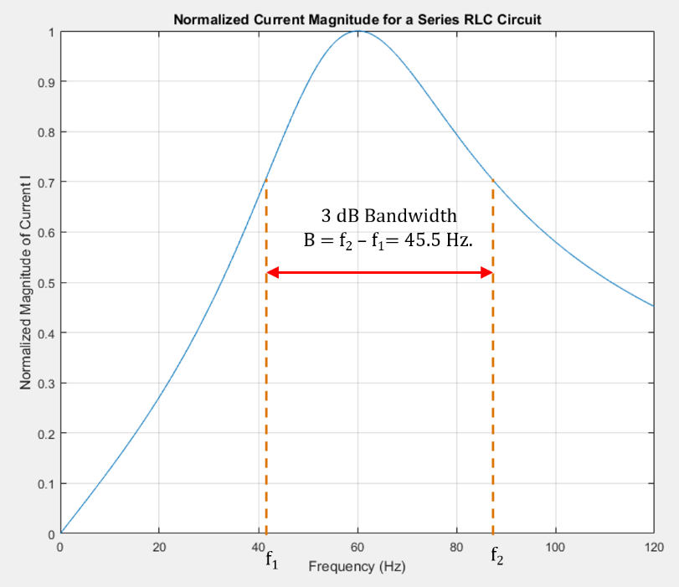
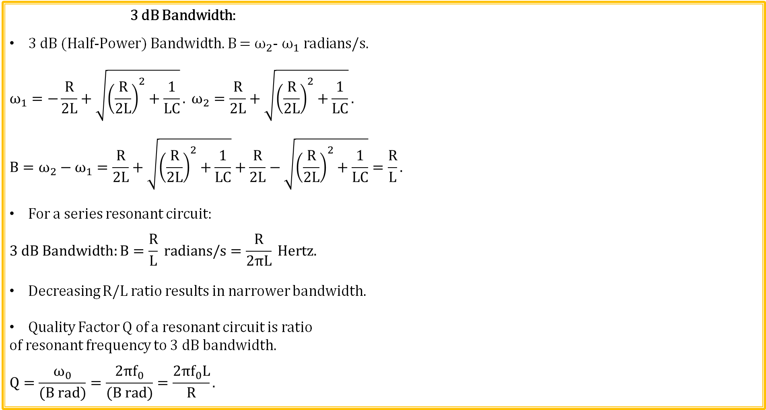
Series Resonance (Continued)
3 dB Bandwidth:
3 dB (Half-Power) Bandwidth. B = $ω_{2}$-${ ω}_{1} radians/s.$
$$ω_{1}=−\frac{R}{2L}+\sqrt{{\left(\frac{R}{2L}\right)}^{2}+\frac{1}{LC}}. ω_{2}=\frac{R}{2L}+\sqrt{{\left(\frac{R}{2L}\right)}^{2}+\frac{1}{LC}}.$$
$$B=ω_{2}−ω_{1}=\frac{R}{2L}+\sqrt{{\left(\frac{R}{2L}\right)}^{2}+\frac{1}{LC}}+\frac{R}{2L}−\sqrt{{\left(\frac{R}{2L}\right)}^{2}+\frac{1}{LC}}=\frac{R}{L}.$$
For a series resonant circuit:
$$3 dB Bandwidth:B=\frac{R}{L} radians/s=\frac{R}{2πL} Hertz.$$
Decreasing R/L ratio results in narrower bandwidth.
Quality Factor Q of a resonant circuit is ratio
of resonant frequency to 3 dB bandwidth.
$$Q=\frac{ω_{0}}{(B rad)}=\frac{2πf_{0}}{(B rad)}=\frac{2πf_{0}L}{R}.$$

Slide 21
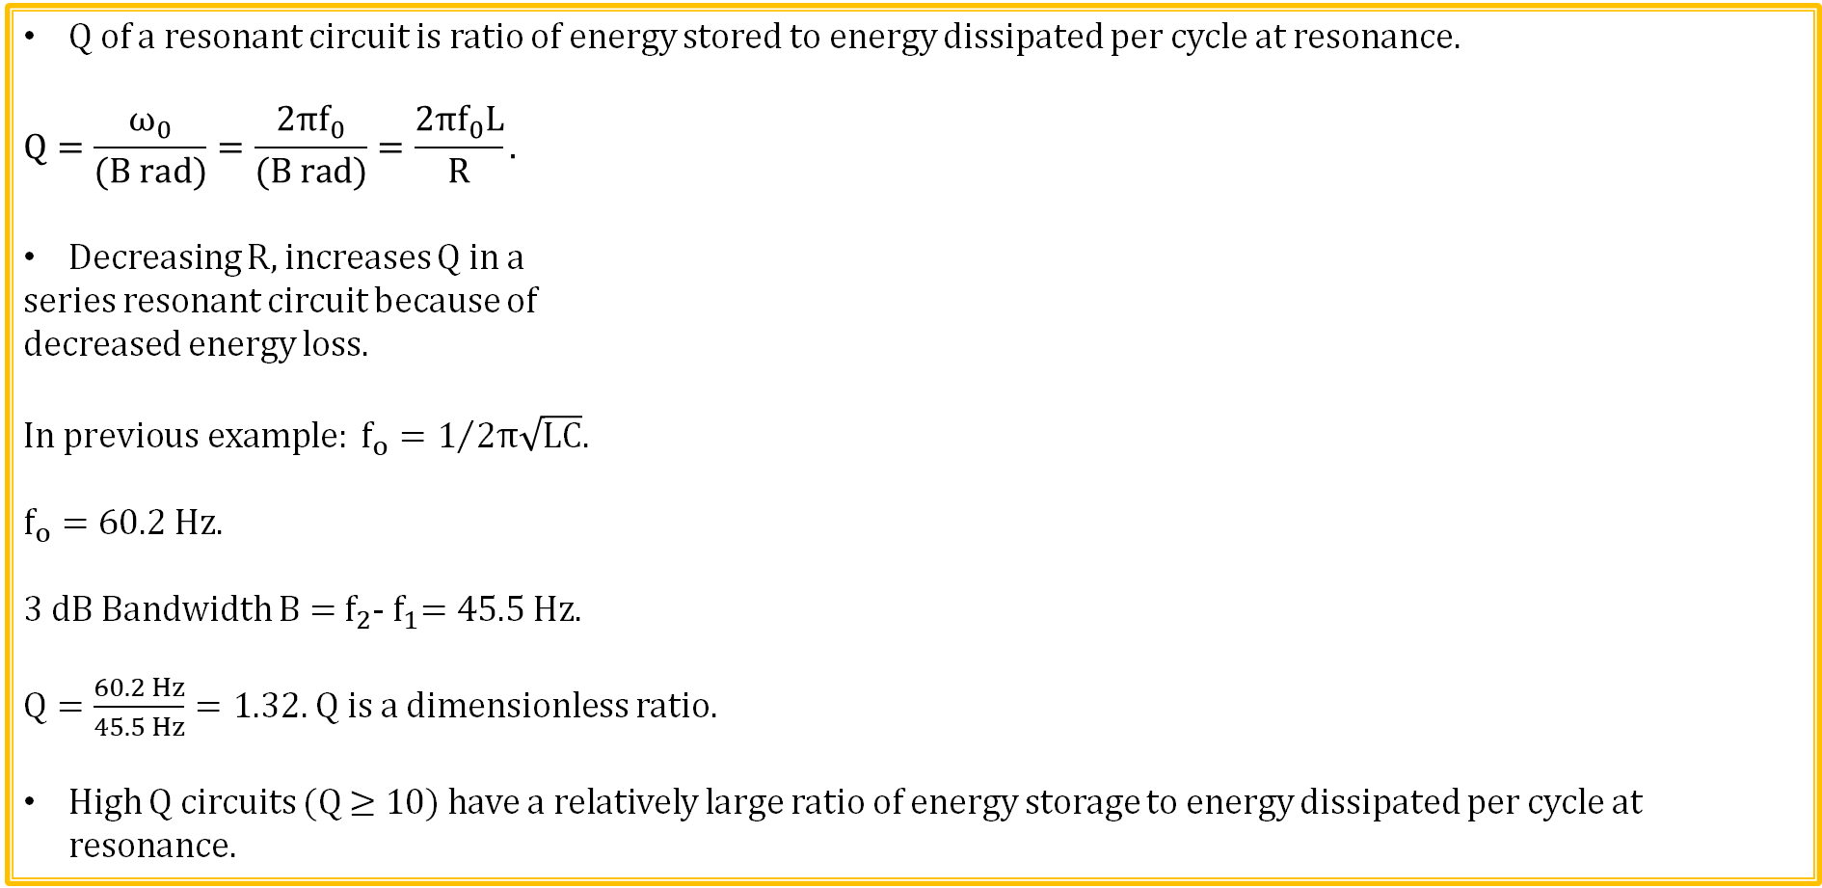
Series Resonance (Continued)
Q of a resonant circuit is ratio of energy stored to energy dissipated per cycle at resonance.
$$Q=\frac{ω_{0}}{(B rad)}=\frac{2πf_{0}}{(B rad)}=\frac{2πf_{0}L}{R}.$$
Decreasing R, increases Q in a
series resonant circuit because of
decreased energy loss.
$${In previous example: f_{o}=1}/{2π\sqrt{LC}.}$$
$$f_{o}=60.2 Hz.$$
3 dB Bandwidth B = $f_{2}$-${ f}_{1}=45.5 Hz.$
$Q=\frac{60.2 Hz}{45.5 Hz}=1.32.$Q is a dimensionless ratio.
High Q circuits (Q ≥ 10) have a relatively large ratio of energy storage to energy dissipated per cycle at resonance.

Slide 22
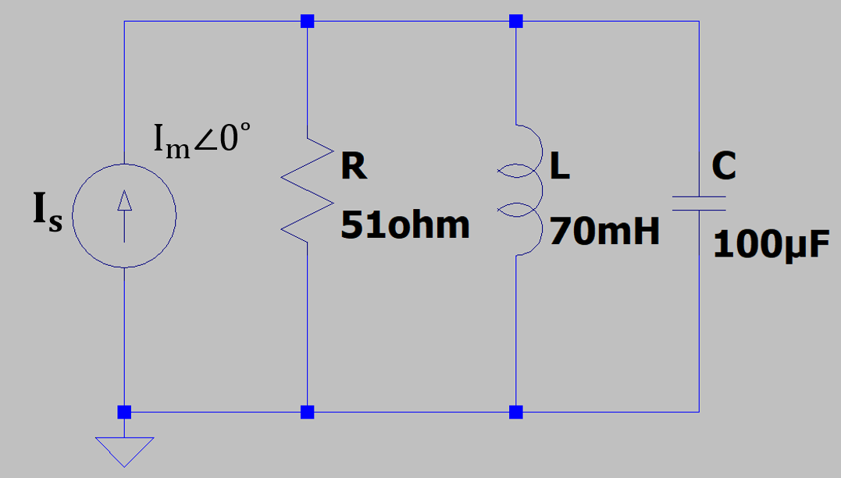
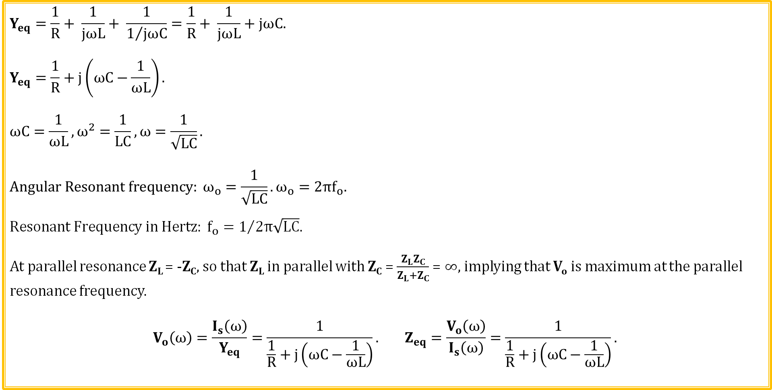
Parallel Resonance
$$Y_{eq}=\frac{1}{R}+ \frac{1}{jωL}+ \frac{1}{1/{jωC}}=\frac{1}{R}+ \frac{1}{jωL}+jωC.$$
$$Y_{eq}=\frac{1}{R}+j\left(ωC−\frac{1}{ωL}\right).$$
$$ωC=\frac{1}{ωL}, ω^{2}=\frac{1}{LC}, ω=\frac{1}{\sqrt{LC}}.$$
$$Angular Resonant frequency: ω_{o}=\frac{1}{\sqrt{LC}}.ω_{o}=2πf_{o}.$$
$${Resonant Frequency in Hertz: f_{o}=1}/{2π\sqrt{LC}.}$$
At parallel resonance Z_{L} = -Z_{C}, so that Z_{L} in parallel with Z_{C} = $\frac{Z_{L}Z_{C}}{Z_{L}+Z_{C}}$ = $∞$, implying that V_{o} is maximum at the parallel resonance frequency.
$$V_{o}\left(ω\right)=\frac{I_{s}\left(ω\right)}{Y_{eq}}=\frac{1}{\frac{1}{R}+j\left(ωC−\frac{1}{ωL}\right)}. Z_{eq}=\frac{V_{o}\left(ω\right)}{I_{s}\left(ω\right)}=\frac{1}{\frac{1}{R}+j\left(ωC−\frac{1}{ωL}\right)}.$$

Slide 23

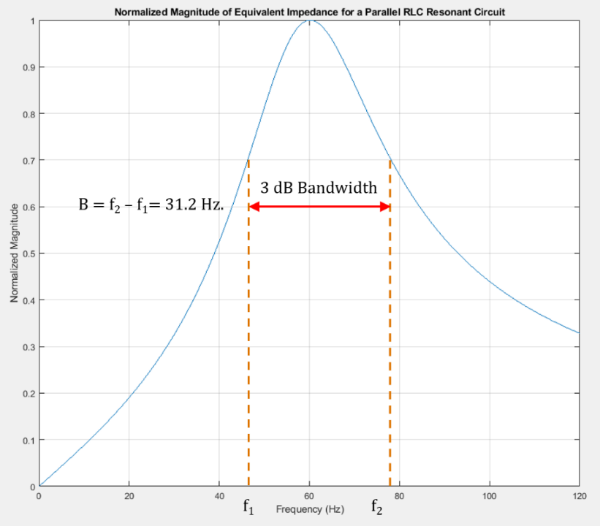
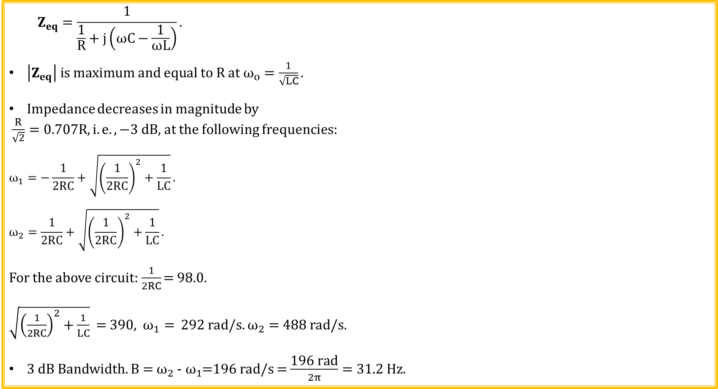
Parallel Resonance (Continued)
$$Z_{eq}=\frac{1}{\frac{1}{R}+j\left(ωC−\frac{1}{ωL}\right)}.$$
$\left|Z_{eq}\right| is maximum and equal to R at ω_{o}=\frac{1}{\sqrt{LC}}.$
Impedance decreases in magnitude by
$\frac{R}{\sqrt{2}}=0.707R, i.e. ,−3 dB,$ at the following frequencies:
$$ω_{1}=−\frac{1}{2RC}+\sqrt{{\left(\frac{1}{2RC}\right)}^{2}+\frac{1}{LC}}.$$
$$ω_{2}=\frac{1}{2RC}+\sqrt{{\left(\frac{1}{2RC}\right)}^{2}+\frac{1}{LC}}.$$
For the above circuit:$\frac{1}{2RC}$ = 98.0.
$\sqrt{{\left(\frac{1}{2RC}\right)}^{2}+\frac{1}{LC}}$ = 390, $ω_{1}=$ 292 rad/s. $ω_{2}=$ 488 rad/s.
3 dB Bandwidth. B = $ω_{2}$ -${ ω}_{1}$=196 rad/s = $\frac{\text{19}\text{6 }\text{rad}}{2π}=31.2 Hz.$

Slide 24

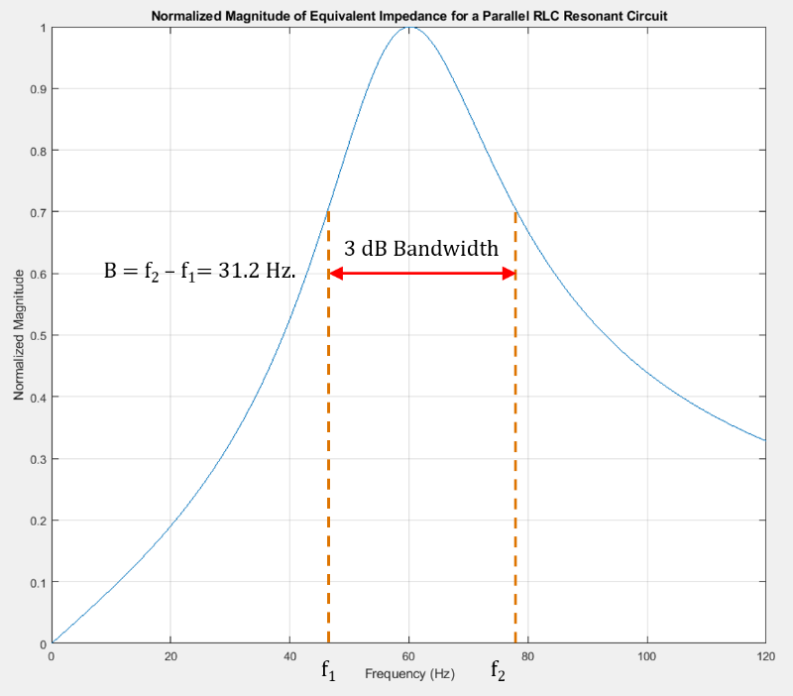
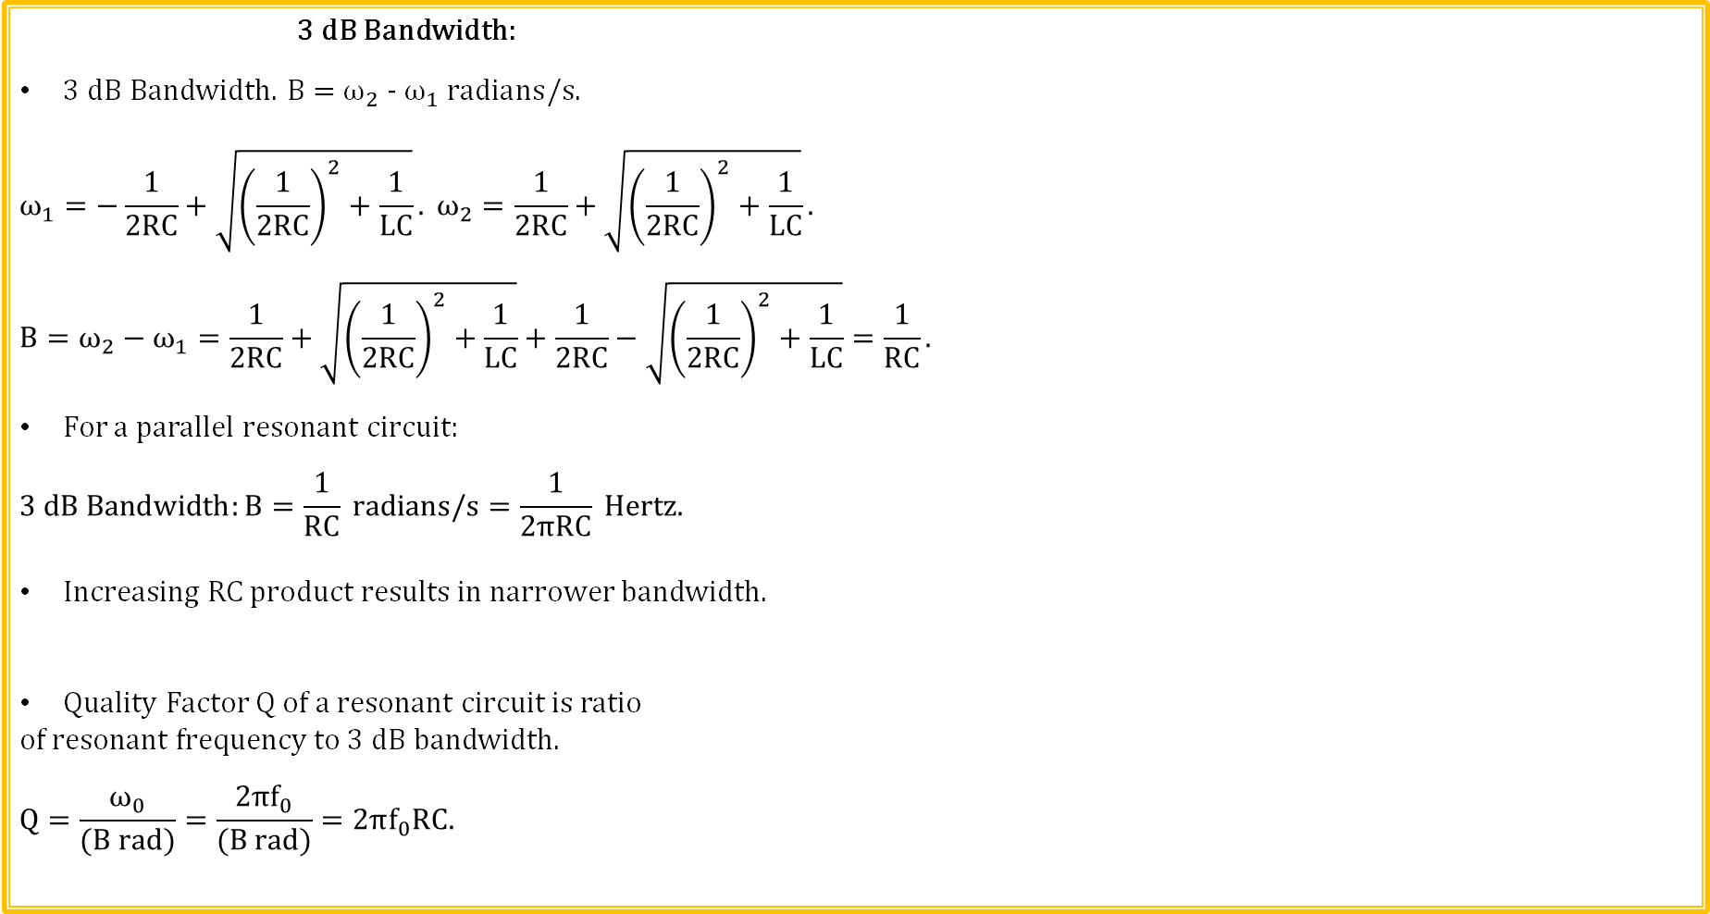
Parallel Resonance (Continued)
3 dB Bandwidth:
3 dB Bandwidth. B = $ω_{2}$ -${ ω}_{1} radians/s.$
$$ω_{1}=−\frac{1}{2RC}+\sqrt{{\left(\frac{1}{2RC}\right)}^{2}+\frac{1}{LC}}. ω_{2}=\frac{1}{2RC}+\sqrt{{\left(\frac{1}{2RC}\right)}^{2}+\frac{1}{LC}}.$$
$$B=ω_{2}−ω_{1}=\frac{1}{2RC}+\sqrt{{\left(\frac{1}{2RC}\right)}^{2}+\frac{1}{LC}}+\frac{1}{2RC}−\sqrt{{\left(\frac{1}{2RC}\right)}^{2}+\frac{1}{LC}}=\frac{1}{RC}.$$
For a parallel resonant circuit:
$$3 dB Bandwidth:B=\frac{1}{RC} radians/s=\frac{1}{2πRC} Hertz.$$
Increasing RC product results in narrower bandwidth.
Quality Factor Q of a resonant circuit is ratio
of resonant frequency to 3 dB bandwidth.
$$Q=\frac{ω_{0}}{(B rad)}=\frac{2πf_{0}}{(B rad)}=2πf_{0}RC.$$

Slide 25

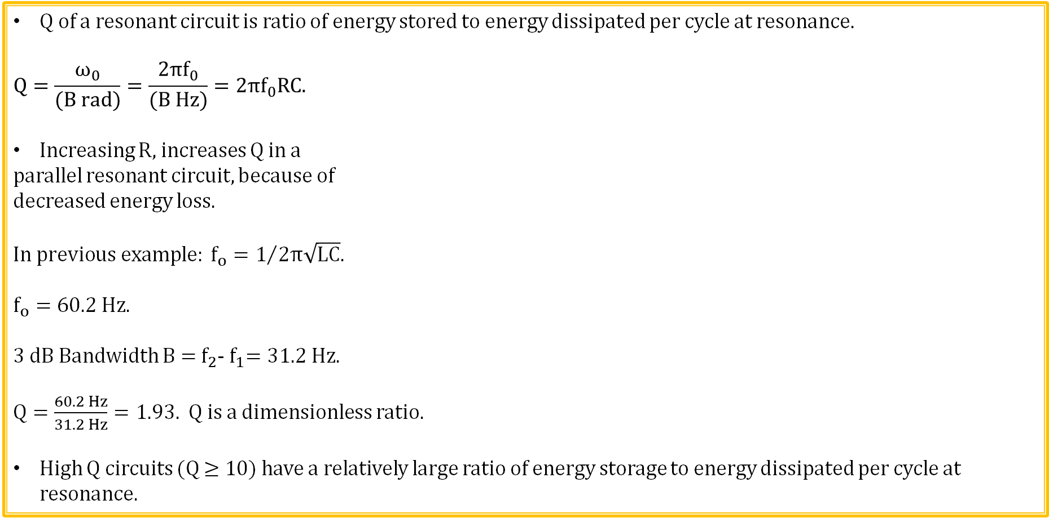
Parallel Resonance (Continued)
Q of a resonant circuit is ratio of energy stored to energy dissipated per cycle at resonance.
$$Q=\frac{ω_{0}}{(B rad)}=\frac{2πf_{0}}{(B Hz)}=2πf_{0}RC.$$
Increasing R, increases Q in a
parallel resonant circuit, because of
decreased energy loss.
$${In previous example: f_{o}=1}/{2π\sqrt{LC}.}$$
$$f_{o}=60.2 Hz.$$
3 dB Bandwidth B = $f_{2}$-${ f}_{1}=31.2 Hz.$
$Q=\frac{60.2 Hz}{31.2 Hz}=1.93.$Q is a dimensionless ratio.
High Q circuits (Q ≥ 10) have a relatively large ratio of energy storage to energy dissipated per cycle at resonance.

Slide 26
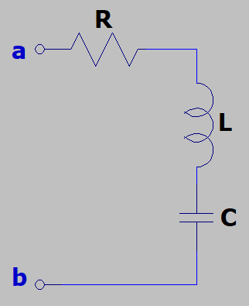
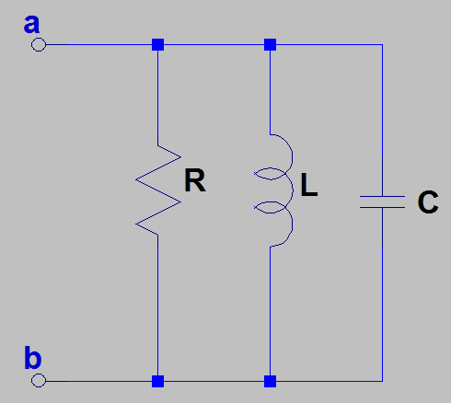
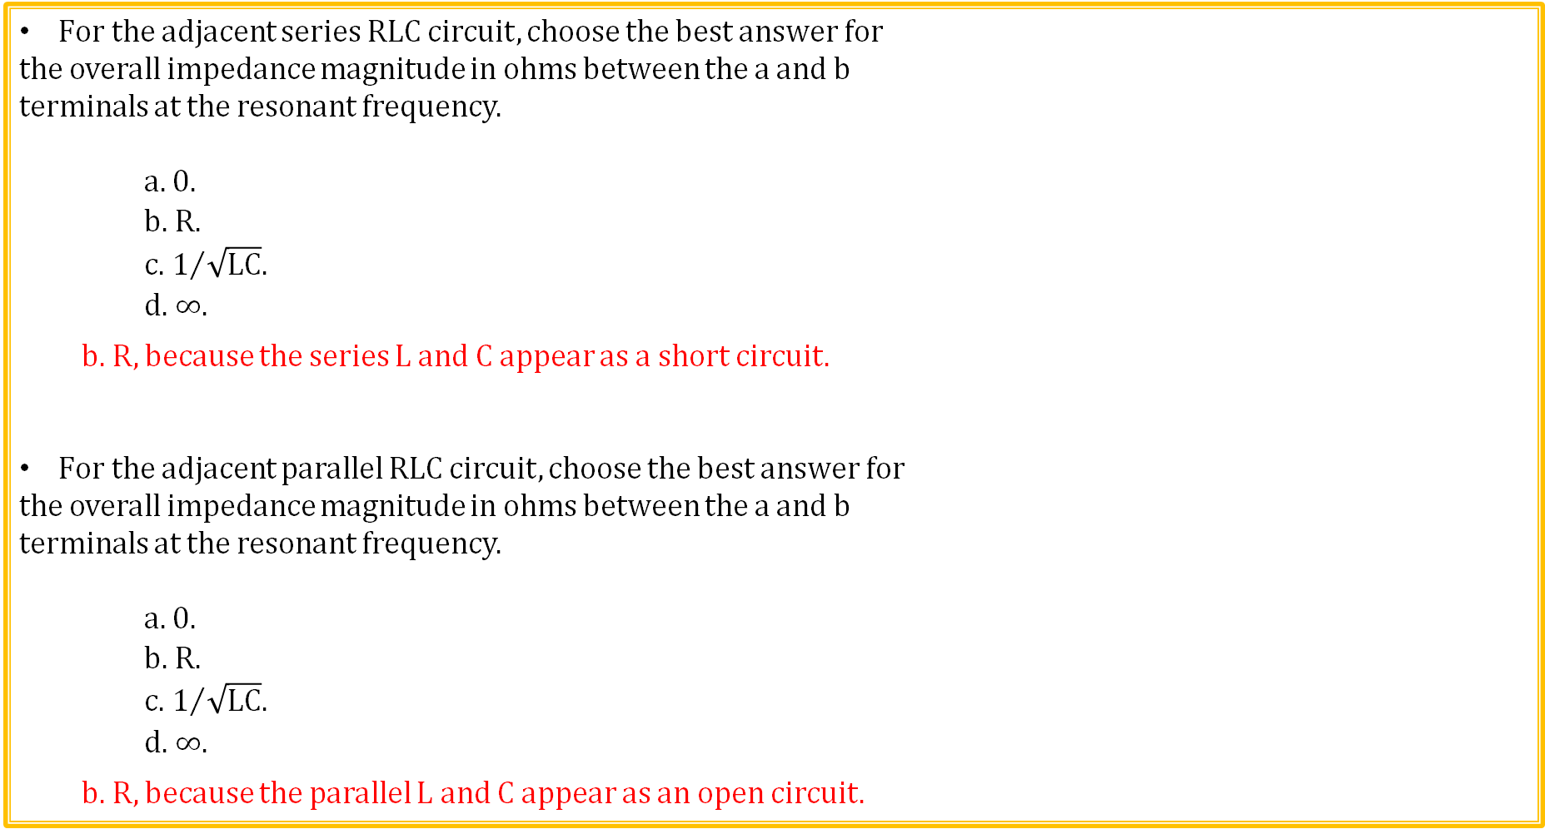
Resonance Review
For the adjacent series RLC circuit, choose the best answer for
the overall impedance magnitude in ohms between the a and b
terminals at the resonant frequency.
a. 0.
b. R.
c. $1/{\sqrt{LC}.}$
d. $∞$.
b. R, because the series L and C appear as a short circuit.
For the adjacent parallel RLC circuit, choose the best answer for
the overall impedance magnitude in ohms between the a and b
terminals at the resonant frequency.
a. 0.
b. R.
c. $1/{\sqrt{LC}.}$
d. $∞$.
b. R, because the parallel L and C appear as an open circuit.

Slide 27
Basic Filter Types
Electrical filters are designed to allow some frequencies through, while blocking (attenuating) others, i.e., frequency discrimination.
A low-pass filter can be used to block (attenuate) unwanted high-frequency noise.

Slide 28
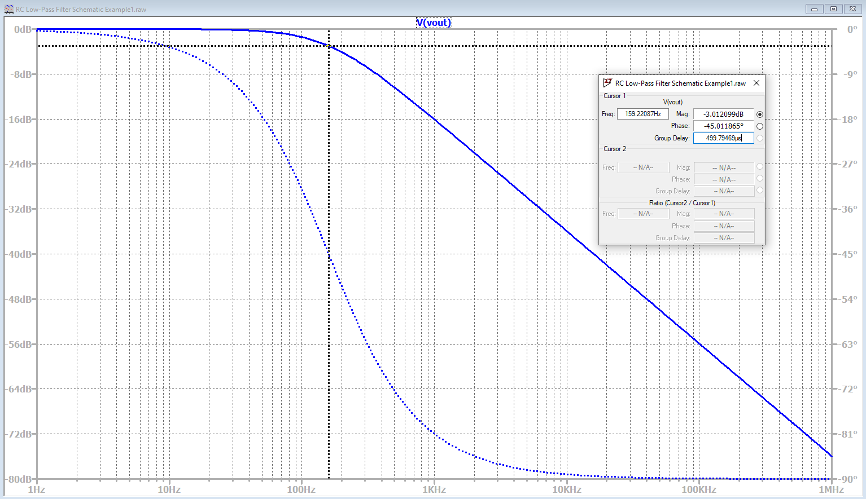
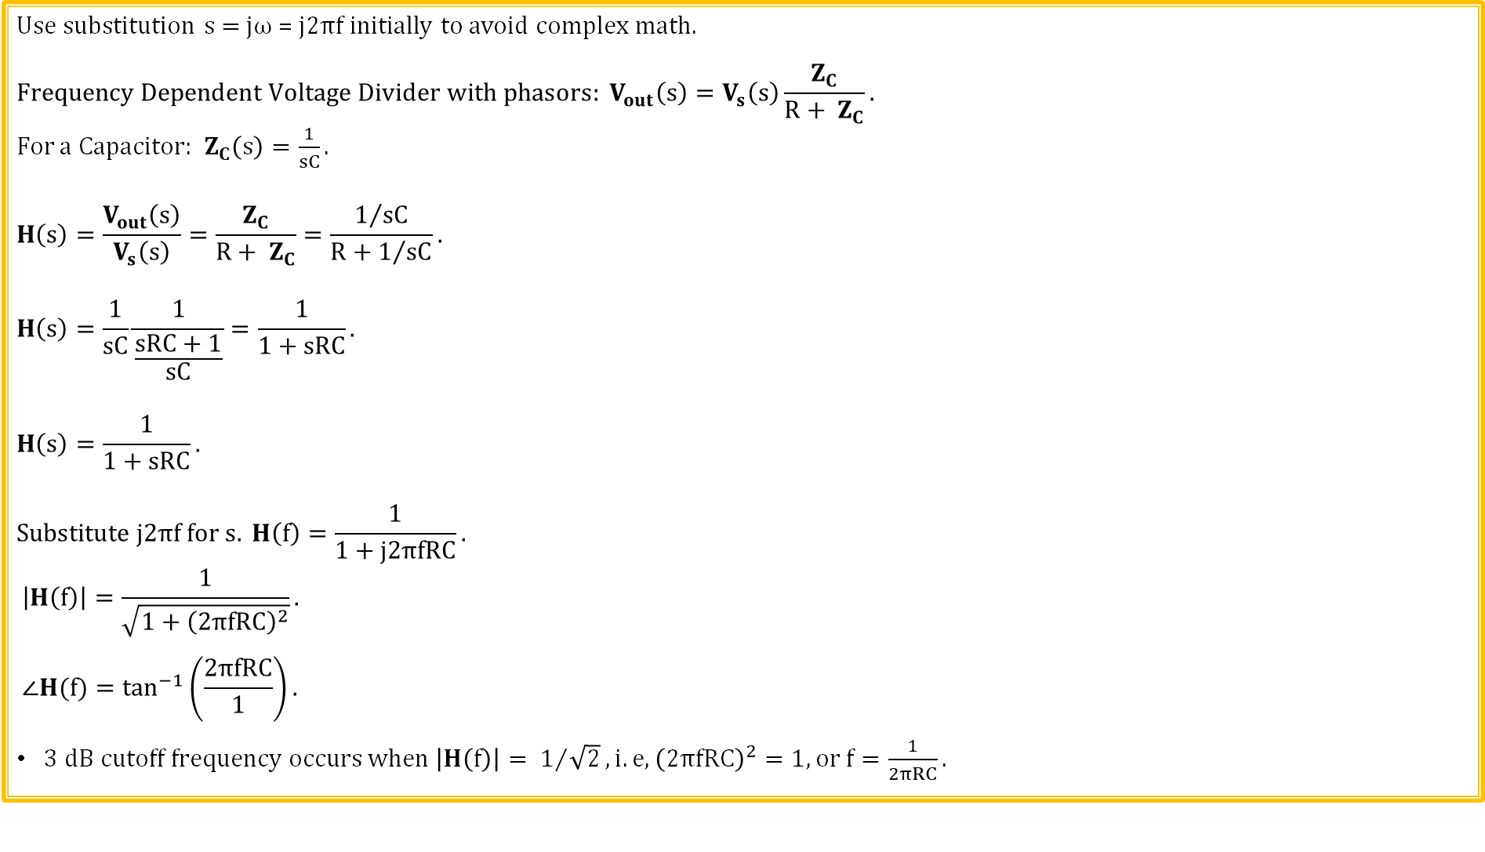
RC Lowpass Filter Frequency Response
Use substitution s = jω = $j2πf$ initially to avoid complex math.
$$Frequency Dependent Voltage Divider with phasors: V_{out}\left(s\right)=V_{s}\left(s\right)\frac{Z_{C}}{R+ Z_{C}}.$$
For a Capacitor: $Z_{C}\left(s\right)=\frac{1}{sC}.$
$$H\left(s\right)=\frac{V_{out}\left(s\right)}{V_{s}\left(s\right)}=\frac{Z_{C}}{R+ Z_{C}}=\frac{1/{sC}}{R+1/{sC}}.$$
$$H\left(s\right)=\frac{1}{sC}\frac{1}{\frac{sRC+1}{sC}}=\frac{1}{1+sRC}.$$
$$H\left(s\right)=\frac{1}{1+sRC}.$$
$$Substitute j2πf for s. H\left(f\right)=\frac{1}{1+j2πfRC}.$$
$$\left|H\left(f\right)\right|=\frac{1}{\sqrt{1+{\left(2πfRC\right)}^{2}}}.$$
$$∠H(f)=\tan^{−1}\left(\frac{2πfRC}{1}\right).$$
$3 dB cutoff frequency occurs when \left|H\left(f\right)\right|= 1/{\sqrt{2}}, i.e, {\left(2πfRC\right)}^{2}=1, or f=\frac{1}{2πRC}.$
LTspice

Slide 29
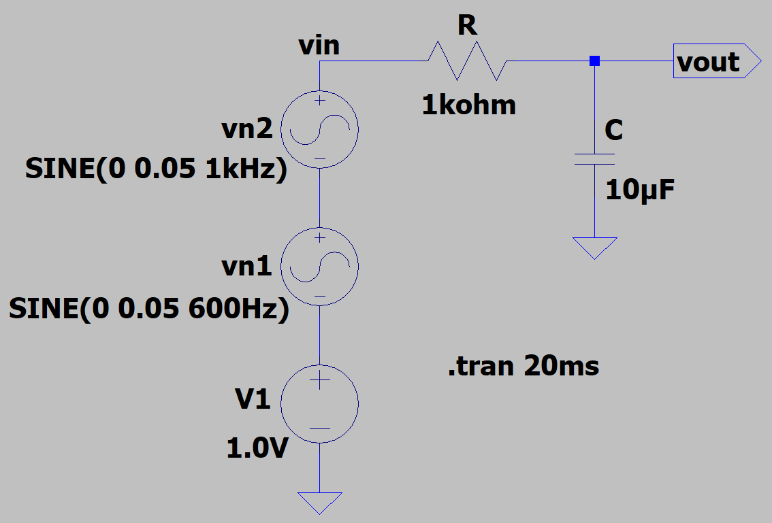
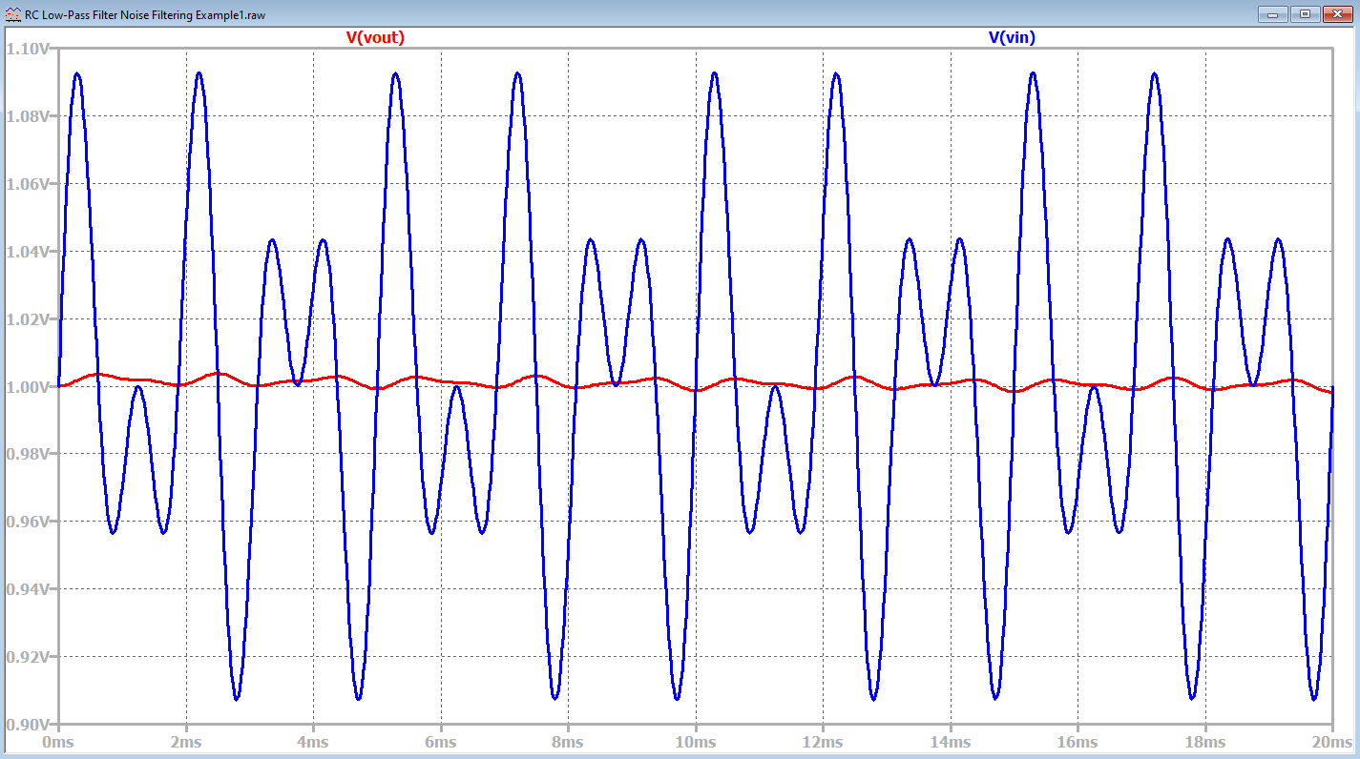
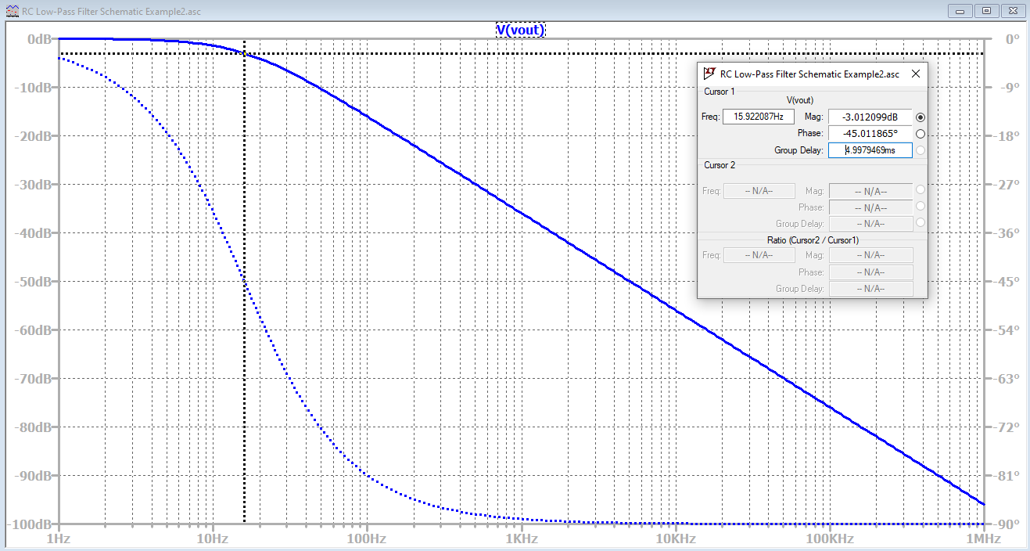
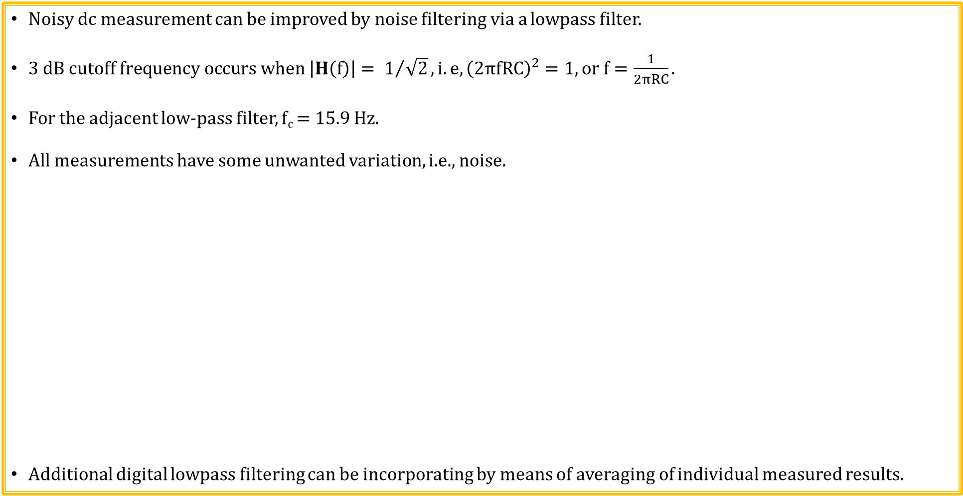
RC Lowpass Noise Filter with f_{c} = 15.9 Hz
Noisy dc measurement can be improved by noise filtering via a lowpass filter.
$3 dB cutoff frequency occurs when \left|H\left(f\right)\right|= 1/{\sqrt{2}}, i.e, {\left(2πfRC\right)}^{2}=1, or f=\frac{1}{2πRC}.$
For the adjacent low-pass filter, f_{c} = 15.9 Hz.
All measurements have some unwanted variation, i.e., noise.
Additional digital lowpass filtering can be incorporating by means of averaging of individual measured results.

Slide 30
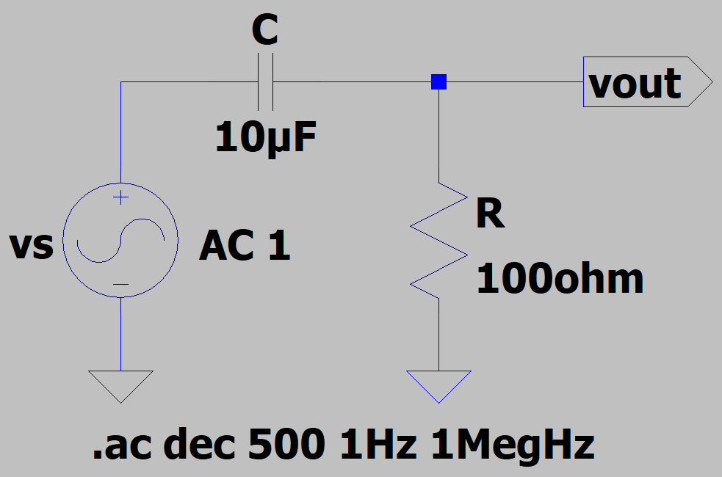
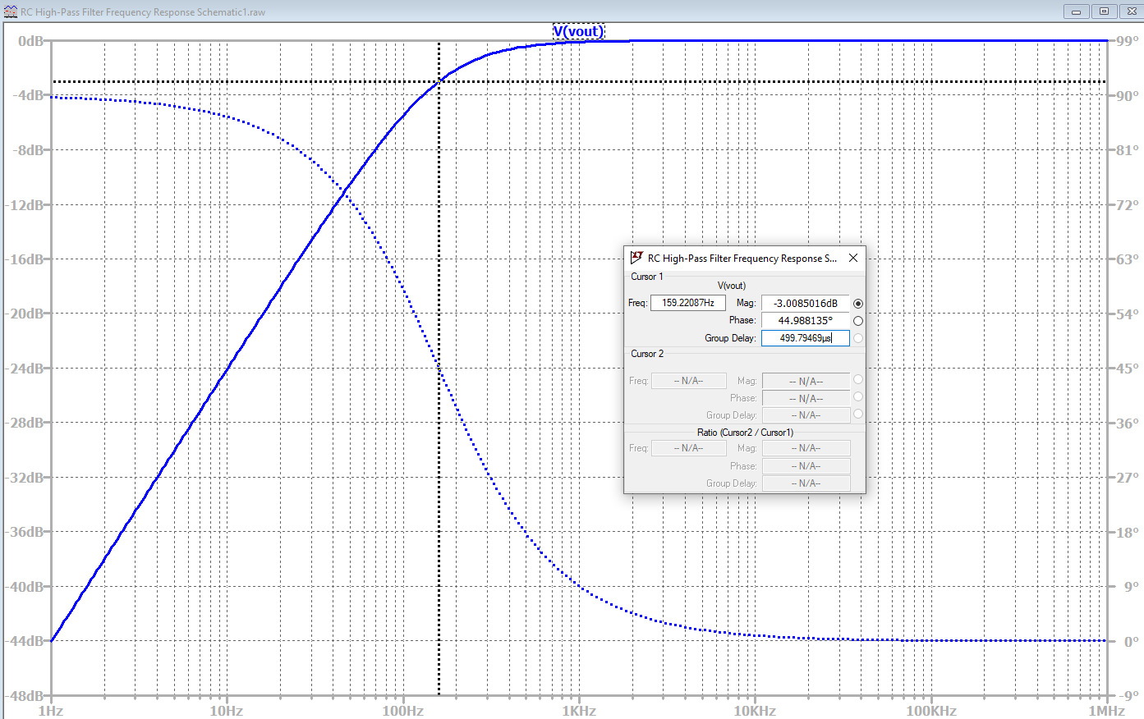
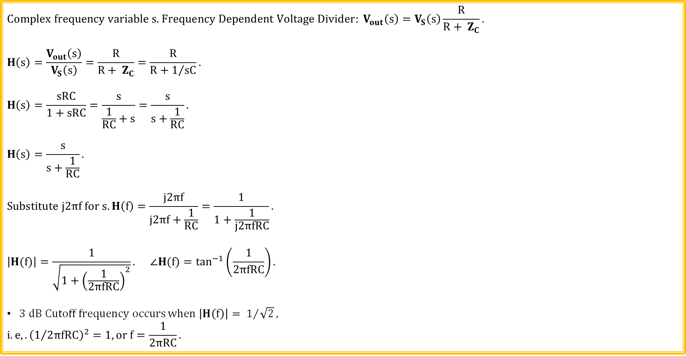
RC Highpass Filter Frequency Response
$$\text{C}\text{omplex} \text{frequency} \text{variable} \text{s}\text{.} Frequency Dependent Voltage Divider: V_{out}\left(s\right)=V_{S}\left(s\right)\frac{R}{R+ Z_{C}}.$$
$$H\left(s\right)=\frac{V_{out}\left(s\right)}{V_{S}\left(s\right)}=\frac{R}{R+ Z_{C}}=\frac{R}{R+1/{sC}}.$$
$$H\left(s\right)=\frac{sRC}{1+sRC}=\frac{s}{\frac{1}{RC}+s}=\frac{s}{s+\frac{1}{RC}}.$$
$$H\left(s\right)=\frac{s}{s+\frac{1}{RC}}.$$
$$Substitute j2πf for s. H\left(f\right)=\frac{j2πf}{j2πf+\frac{1}{RC}}=\frac{1}{1+\frac{1}{j2πfRC}}.$$
$$\left|H(f)\right|=\frac{1}{\sqrt{1+{\left(\frac{1}{2πfRC}\right)}^{2}}}. ∠H(f)=\tan^{−1}\left(\frac{1}{2πfRC}\right).$$
$3 dB Cutoff frequency occurs$ $when \left|H\left(f\right)\right|= 1/{\sqrt{2}},$
$$i.e,.{\left(1/{2πfRC}\right)}^{2}=1, or f=\frac{1}{2πRC}.$$
LTspice

Slide 31
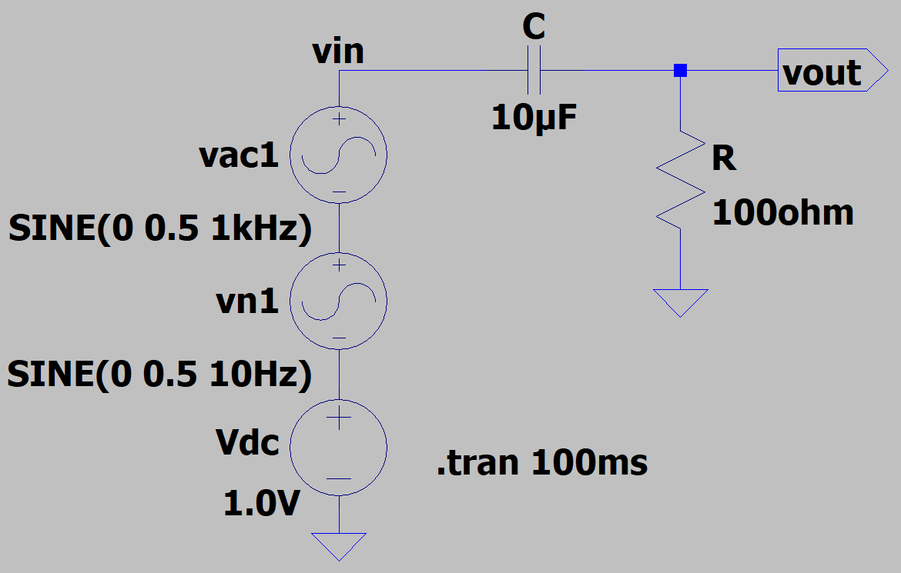
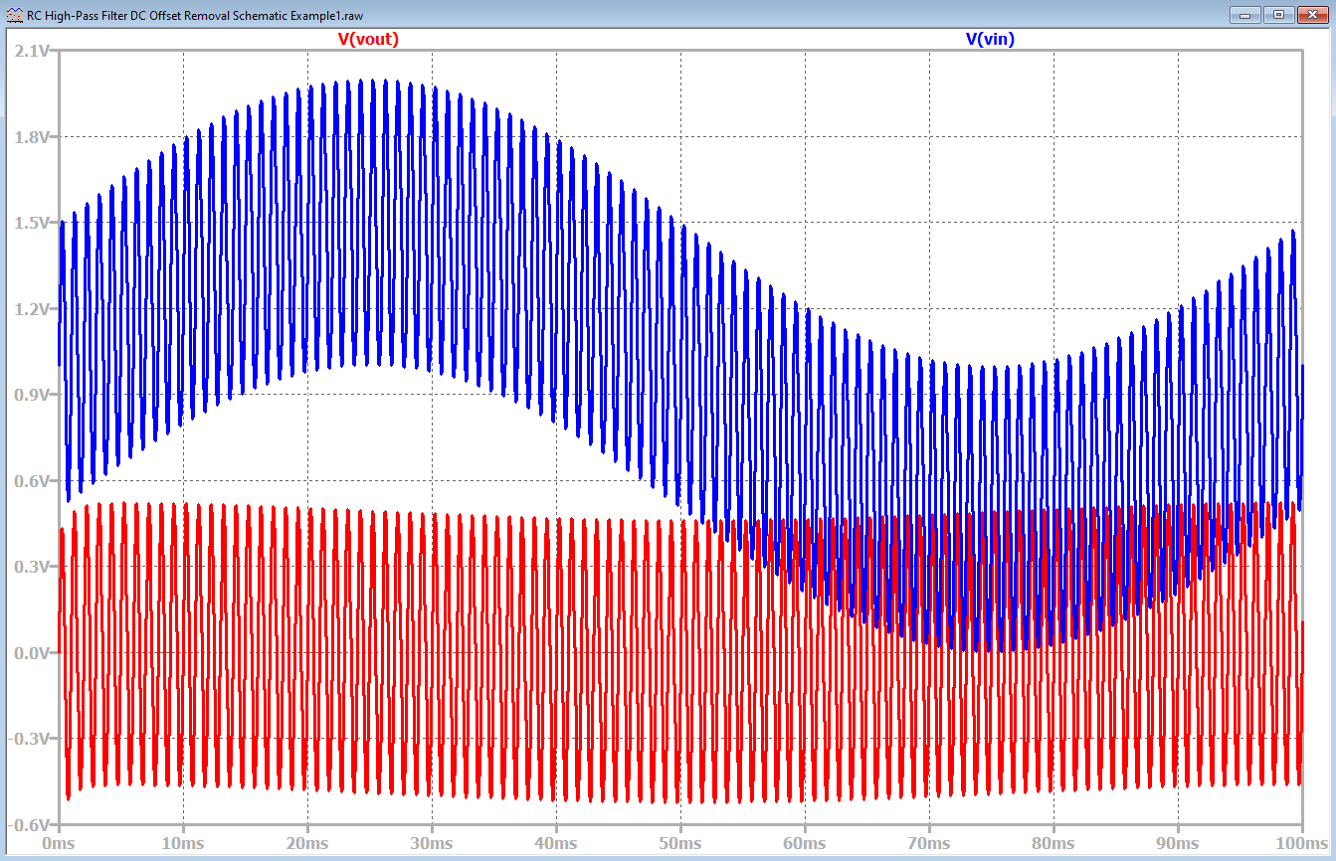
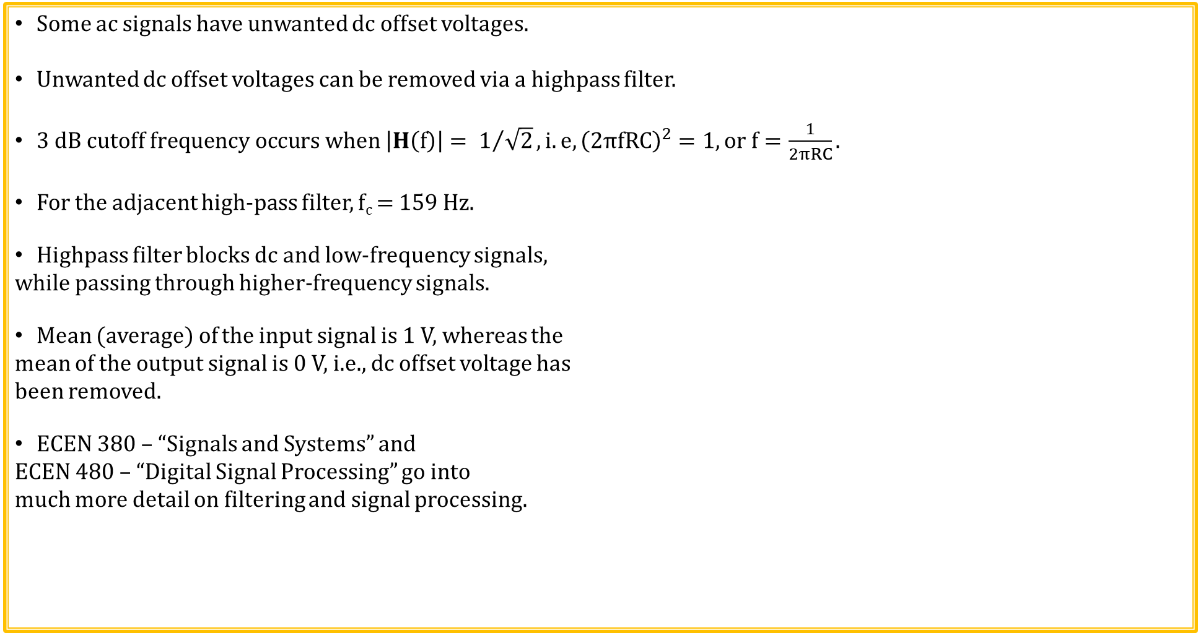
RC Highpass Filter with f_{c} = 159 Hz
Some ac signals have unwanted dc offset voltages.
Unwanted dc offset voltages can be removed via a highpass filter.
$3 dB cutoff frequency occurs when \left|H\left(f\right)\right|= 1/{\sqrt{2}}, i.e, {\left(2πfRC\right)}^{2}=1, or f=\frac{1}{2πRC}.$
For the adjacent high-pass filter, f_{c} = 159 Hz.
Highpass filter blocks dc and low-frequency signals,
while passing through higher-frequency signals.
Mean (average) of the input signal is 1 V, whereas the
mean of the output signal is 0 V, i.e., dc offset voltage has
been removed.
ECEN 380 – “Signals and Systems” and
ECEN 480 – “Digital Signal Processing” go into
much more detail on filtering and signal processing.

Slide 32


Source Transformations
Source transformation relationships: R = R, i_{s} = v_{s}/R, v_{s} = i_{s}R.
Resulting resistance R, stays the same for the above source transformations.
Resonant frequency and 3 dB bandwidth equations also stay the same for the above parallel resonant circuit source transformation.
v_{s} = i_{s}R
i_{s} = v_{s}/R

Slide 33


Bandpass Filter Using Parallel Resonance
Frequency Dependent Voltage Divider:
$$V_{out}\left(ω\right)=\frac{V_{s}\left(ω\right)Z_{LǁC}}{R+Z_{LǁC}}.$$
At DC, $\left|V_{out}\left(ω\right)\right|=0,$because of inductor L.
At high frequency AC, $\left|V_{out}\left(ω\right)\right| approaches 0,$
because of capacitor C.
$\left|V_{out}\left(ω\right)\right| is maximum and equal to V_{m} at ω_{o}=\frac{1}{\sqrt{LC}},$because $Z_{LǁC}=∞ at ω_{o}.$
Transfer Function: Use the substitution s = jω to avoid complex math for now.
$$H\left(s\right)=\frac{V_{out}\left(s\right)}{V_{s}\left(s\right)}=\frac{Z_{LǁC}}{R+Z_{LǁC}}, Z_{LǁC}=\frac{Z_{L}Z_{C}}{Z_{L}+Z_{C}}=\frac{\frac{sL}{sC}}{sL+1/{sC}}=\frac{\frac{sL}{sC}}{\frac{s^{2}LC+l}{sC}}=\frac{sL}{1+s^{2}LC}.$$
$$H\left(s\right)=\frac{\frac{sL}{1+s^{2}LC}}{R+\frac{sL}{1+s^{2}LC}}=\frac{\frac{sL}{1+s^{2}LC}}{\frac{R+sL+s^{2}RLC}{1+s^{2}LC}}=\frac{sL}{R+sL+s^{2}RLC},H\left(s\right)=\frac{sL}{R+sL+s^{2}RLC}.$$

Slide 34



Bandpass Filter (Continued)
From previous slide: $H\left(s\right)=\frac{sL}{R+sL+s^{2}RLC}.$
Substitute jω for s.
$$H\left(ω\right)=\frac{jωL}{{R−ω}^{2}RLC+jωL}.$$
Resulting circuit is a band-pass filter with a
center frequency of 60 Hz and 3 dB bandwidth
of 31.3 Hz.
${Resonant Frequency in Hertz: f_{o}=1}/{2π\sqrt{LC}.}$
At parallel resonance Z_{L} = -Z_{C}, so that Z_{L}ǁZ_{C} = $∞$,
implying that magnitude of Vo is maximum at the
parallel resonance frequency.

Slide 35


Bandpass Filter (Continued)
Bode Plots.
MATLAB
LTspice

Slide 36


Bandstop (Notch) Filter Using Series Resonance
Frequency dependent voltage divider using phasors.
$$V_{out}\left(ω\right)=\frac{V_{s}\left(ω\right)Z_{L\&C}}{R +{ Z}_{L\&C}}.$$
At DC, $\left|V_{out}\left(ω\right)\right|=V_{m},$because of capacitor C.
At high frequency AC, $\left|V_{out}\left(ω\right)\right| approaches V_{m},$
because of inductor L.
$\left|V_{out}\left(ω\right)\right|=0 at ω_{o}=\frac{1}{\sqrt{LC}},$because $Z_{L\&C}\left(ω\right)=0.$
Resulting circuit is a band-stop filter with a notch frequency of 60 Hz.
Transfer Function: Use the substitution s = jω to avoid complex math for now.
$$Voltage Divider: V_{out}\left(s\right)=\frac{\left(1/{sC+sL}\right)V_{s}\left(s\right)}{R+sL+1/{sC}}.$$
$$H\left(s\right)=\frac{V_{out}\left(s\right)}{V_{s}\left(s\right)}=\frac{{\left(s^{2}LC+1\right)}/{sC}}{{\left(sRC+ s^{2}LC+1\right)}/{sC}}=\frac{s^{2}LC+1}{s^{2}LC+sRC+1}.$$

Slide 37



Bandstop (Notch) Filter (Continued)
$$\text{From} \text{previous} \text{slide}\text{:} H\left(s\right)=\frac{s^{2}LC+1}{s^{2}LC+sRC+1}.$$
$$Substitute jω for s.$$
$$H\left(ω\right)=\frac{1−ω^{2}LC}{1−ω^{2}LC+jωRC}.$$
Resulting circuit is a band-stop (notch) filter with a
notch frequency of 60 Hz and 3 dB bandwidth
of 31.3 Hz.
$${Resonant Frequency in Hertz: f_{o}=1}/{2π\sqrt{LC}.}$$
At series resonance Z_{L} = -Z_{C}, so that Z_{L}ǁZ_{C} = $0$,
implying that magnitude of V_{out} is zero at the
series resonance frequency.

Slide 38



Bandstop (Notch) Filter (Continued)
Bode plots.
MATLAB
LTspice

Slide 39
The End

Slide 40
Extra

Slide 41


Voltage Gain in decibels (dB)
Phasor X(ω)
Linear Network
H(ω)
Phasor Y(ω)
$$H\left(ω\right)=\frac{Y(ω)}{X(ω)}=\left|H\left(ω\right)\right|∠ϕ.$$
$$\text{Voltage} \text{Gain}\text{: }\text{AV}\text{_}\text{dB}\text{ = }{20log}_{10}\left(\left|H\left(ω\right)\right|\right).$$
Since $ω=2πf, \left|H\left(ω\right)\right|$ and/or $\left|H\left(f\right)\right|$ can be determined from an oscilloscope at various frequencies simply by measuring the peak sinusoidal input value and the peak sinusoidal output value and calculating the ratio of the results at each frequency of interest.
The logarithm of a reciprocal of a quantity is simply the negative logarithm of that quantity.

Slide 42


Reactance – Magnitude of Impedance
Capacitive Reactance: $X_{C}=\frac{Vrms}{Irms}=\frac{1}{2πfC}$. Inductive Reactance: $X_{L}=\frac{Vrms}{Irms}=2πfL$.
For circuits having series R and C or parallel R and C components, the frequency at which $X_{C}=X_{L}$ is a special frequency referred to as resonance.
Resulting impedance behavior depends upon whether capacitor and inductor are in series, i.e., series resonance, or in parallel, i.e., parallel resonance.

Slide 43

Bode Plots
Bode magnitude plot utilize dB magnitude axis versus logarithmic frequency axis.
Bode phase plot utilizes linear phase axis in degrees versus logarithmic frequency axis.
Originally referred to a straight-line
approximation to the actual filter response, but
now also refers to exact calculated and/or
measured values.
Regarding the straight-line approximation to
the magnitude of the transfer function, the slope
increases by 20 dB/decade well beyond a pole
frequency. (The slope of the magnitude increases
by 20 dB/decade well beyond a zero frequency).
Regarding the straight-line approximation to
the phase shift of the transfer function, there is a
-45˚ phase shift at the pole frequency and a -90˚ phase shift well beyond the pole frequency. (The phase shifts by +45˚ at a zero frequency and +90˚ well beyond a zero frequency).
Slope of 0 dB/decade.
-3.01 dB gain on actual response at Break point or pole frequency
Slope of -20 dB/decade after break point or pole frequency.
Straight-line approximations to transfer function magnitude.
Actual transfer function magnitude.
0˚ phase shift.
Straight-line approximations to transfer function phase.
Actual transfer function phase.
-45˚ phase shift at Break point or pole frequency.
-90˚ phase shift.

Slide 44

Logarithmic Scale
Logarithmic Scale → Increase is linear in the exponent, rather than the overall value.
10^{0.5} = 3.16. So 3.16 is ½ way between 10⁰ = 1 and 10¹ = 10 on a base 10 logarithmic scale.
10^{1.5} = 31.6. So 31.6 is ½ way between 10¹ = 10 and 10² = 100 on a base 10 logarithmic scale.

Slide 45

Exponents and Logarithms (Continued)
Since (Any Base)⁰ = 1, x = log_{(Any Base)}(1) = 0.
Negative x = log_{b}(a) values occur for argument a ranging between 0 to 1.
log₁₀(0.1) = -1.0, i.e., 10⁻¹ = 1/10 = 0.1.
Exponential form
Logarithmic form
exponent
a = b^{x} x = log_{b}a
base
The logarithm of a reciprocal of a quantity is simply the negative logarithm of that quantity.
For example, log₁₀(10) = 1.0, whereas log₁₀(1/10) = -1.0. (Reciprocals)

